Slide 1

View caller

Slide 2
Contents
1.OVERVIEW AND SOFTWARE REQUIREMENTS SPECIFICATION:
0- Introduction:…………………..............................................................................……………………………4
0.1- PURPOSE:………………….............................................................................……………………………….5
0.2- PROJECT SCOPE: ……………................................................................................………………………..6
0.3-STOCKHOLDE..…………………………............................................................................…………………..7
0.4-Advantages:………………………………............................................................................………………….8
0.5- References: :…………………...………………............................................................................………..9
PHASE 1: …………………………………………………………...........................................................................….10
1- FUNCTIONAL & NON-FUNCTIONAL REQUIREMENTS: …………………………………………………………………11 1.1-USER REQUIREMENTS SPECIFICATION:…………………………………………………………….............…………..12
1.2- ADMIN REQUIREMENTS SPECIFICATION:…………..........................…………………………………………….37
1.3- NON-FUNCTIONAL REQUIREMENTS SPECIFICATION:…………..........…………………………………………..43

Slide 3
2. SYSTEM DESIGN AND MODELS: -
2- USE-CASE DIAGRAMS: …………………………………………………………………………………………………………………................……….…48
2.1- System Environment: …………………………………………………………………………………………………………………….............………….49
2.2- Use case Diagrams: …………………………………………………………………………………………………………………...........………………..50
2.2.1- User Use Case Diagrams: ………………………………………………………………………………………………………………............……….51
2.2.2 Admin Use Case Diagrams: ……………………………………………………………………………………………………………………...............102
3- ACTIVITY DIAGRAMS: ………………………………………………………………………………………………………………................................115
3.1- User Activity Diagrams: …………………………………………………………………………………………………………………………............….116
3.2- Admin Activity Diagrams: ……………………………………………………………………………………………………………………..........…….135
4- DATABASE SPECIFICATION: ……………………………………………………………………………………………….................……141
4.1- Entity Relationship diagram (ERD): ……………………………………………………………………………………………………..142
4.2- Tables Models: ………………………………………………………………………………………………………………………………......143
5- Class Diagram: …………………………………………………………………………………………………………………….................…144
5.1- Class Diagram Initial Version: ………………………………………………………………………………………………………………145
5.2- Class Diagram intermediate Version………………………………………………………………………………………………….…146
5.3- Class Diagram final Version: ………………………………………………………………………………………………………………147
6- SEQUENCE DIAGRAMS: ………………………………………………………………………………………………….................………149
6.1- User Sequence Diagram : ……………………………………………………………………………………….................…………..150
6.2- Admin Sequence Diagram : ………………………………………………………………………………................…………….….156
6.3- System Sequence Diagram User : ………………………………………………………………………................…………….…158
7- Package Diagram: …………………………………………………………………………………………………………………..................................162
7.1- Package Diagram Use Cases : ……………………………………………………………………………...................................……………….163
7.2- Package Diagram Classes : ………………………………………………………………………....................................…………………………164

Slide 4
8- object Diagram: …………………………………………………………………………………………………………………..................................165
8.1- object Diagram : ……………………………………………………………………………...................................………………………………..166
9- SYSTEM ARCHITECTURE: ……………………………………………………………………………………...............................………………….167
9.1- Client - Server Architecture mixed Database (BLACK-BOARD) : ……………………………...............................……………..168
PHASE 2 : ……………………………………………………………………………………………………………………………………………………………….168
10- COLLABORATION/COMMUNICATION DIAGRAMS: ………………………………………………………………………………………..…169
10.1 User Collaboration /Communication Diagram : .…………………………………………………………………………….…….…….…..170
10.2Admin Collaboration /Communication Diagram : ……………………………………………………………………..…….………………176
11- Mandatory Design Pattern Applied: …………………………………………………………………………………………………………184

Slide 5

0 introduction

Slide 6
0.1 Purpose
view-caller is system has features of caller-identification,call-blocking,flash-messaging,callrecording,chat and voice which uses the internet .The service requires users to provide a standard cellular mobile number for registering with the service .The purpose of the software True-caller is to overcome the situations of responding to an unknown contact. Here the software acts as a guard and allows the user know about any unknown person’s details.
Our team provide a web application that intent to cover and deal with all aspects of this process and provide other services.

Slide 7
0.2 Project Scope
True-caller, one of the going-to-be successful software in the app market, has an excellent feature of allowing the user to know about any unknown person’s details if he/she has phoned. Developments and upgrades were to be done according to that, and most importantly, maintenance is to be done with every upcoming version of this product.
The system can be used by anyone has a smartphone or pc.

Slide 8
0.3 Stockholder
1. The Admin: the manager of the system
2. The User : the person who want to user our system ,know about any unknown call’s details and use our features of caller-identification,call-blocking,flash-messaging,callrecording,chat and voice.
3. IT Staff: who are responsible for installing and maintaining the system.

Slide 9
0.4 Advantages
The app’s key benefit is that it assists you in detecting and managing spam in both calls and messages.
It makes it much easy to find everyone’s numbers.
It may be useful in the fight against robocalls.
Also when someone use secret number to phone, this will expose whom they actually are.

Slide 10
0.5 References:
• Dr. Amr Ghoneim’s Lectures.
Ian Sommerville, "Software Engineering (9th Edition)", Addison Wesley, ISBN: 978-0137035151, 2010
Head First Design Patterns(Eric Freeman Elisabeth Freeman)
Design Patterns FOR DUMMIES(by Steve Holzner, PhD)
https://support.truecaller.com/support/solutions/81000196629
https://www.truecaller.com/privacy-policy
https://app.diagrams.net/#
https://www.uccs.edu/Documents/tboult/srs.doc
https://en.wikipedia.org
https://www.quora.com/

Slide 11

Phase 1

Slide 12

1 Functional REQs & Non-Functional REQs

Slide 13
1.1user Functional REQs

Slide 14
Registration
Function Name | Registration
Actors | User
Goal | the new users can register a new profiles in the system to benefit from the features of it.
Pre- conditions | None.
Post- conditions | the user is successfully registered in the system and the user will get a screen of login and Now he/she can login in the system with his/her username and password.
input | 1.Username 2.Password 3.Email 4.First Name 5.Last Name 6.Gender 7.Age
output | The user has registered into the system.
Description | the user can access the Intelligent Tourist System by register in the system using (Username, Password, E mail, First name, Last name, Gender, Age) and the system compares between the username sent by user and the existing usernames stored in the online database.

Slide 15
Login
Function name | Login
Actor | User
Goal | The user login to the system to access different benefits of it.
Pre- conditions | User must connect to the internet and registered previously in the system and enter his/her data (username, password) correctly.
Post- conditions | If the login use case was successful, the actor (user) is now logged into the system. If not the system will display login error and the user will get a screen with 2 tabs
Input | 1.Username 2.Password
Output | The user has logged into the system.
Description | This login function describe how a user can log into the system using username and password and the system compares between the data sent by user and the existing data stored in the online database.

Slide 16
View profile
Function name | View profile
Actor | User
Goal | The user can access his/her data
Pre- conditions | the user must be registered and logged on the system.
Post-conditions | The user can view his/her data (Username, Password, E-mail, First name, Last name, Gender, Age).
Input | None
Output | The user has viewed his/her data.
Description | The user can view his/her data (Username, Password, E-mail, First name, Last name, Gender, Age) by retrieving it from the online database for the username just logged in

Slide 17
Search
Function name | search
Actor | User
Goal | the user make a manual search for a specific no. or name
Pre- conditions | the user must be registered and logged on the system choose the Manual search Tab.
Post-conditions | Based on the requirements provided by the user, he/she can view the no. or name he/she searched about it.
Input | Phone number Or name of the person
Output | The user has searched manually for the information he/she wants.
Description | this function help user to get information about other user by searching with the name or the phone number

Slide 18
Write feedback
Function name | Write feedback
Actor | User
Goal | Send feedback of the experience to help the system and admin to adjust their behaviour and/or improve their performance or inform a complaint.
Pre- conditions | the user must be registered and logged on the system.
Post-conditions | An message appears that “your feedback is sent successfully”
Input | The feedback of the user
Output | The user has submitted the feedback about the system.
Description | Users can give their feedback about the system by rating it from one to ten and leave a comment to explain the advantages and disadvantages of the system

Slide 19
BLOCKING NUMBERS FROM FOREIGN COUNTRIES:
Function name | BLOCKING NUMBERS FROM FOREIGN COUNTRIES
Actor | User
Goal | Only numbers from your country will be able to call you
Pre- conditions | the user must be registered and logged on the system and go to manage blocking settings
Post-conditions | The user will receive call from inside the country only
Input | go to manage blocking settings tap on block numbers from foreign countries.
Output | blocked successfully
Description | The user will not receive any call from another country and this is an optional service

Slide 20
BLOCK NUMBERS NOT IN THE PHONEBOOK:
Function name | BLOCK NUMBERS NOT IN THE PHONEBOOK
Actor | User
Goal | Not everyone can call the user only the people in his /her phonebook
Pre- conditions | the user must be registered and logged on the system and go to manage blocking settings
Post-conditions | The user will receive only calls from people in his /her phonebook
Input | go to manage blocking settings tap on block numbers not in phonebook.
Output | blocked successfully
Description | Only people in your phonebook will be able to call you

Slide 21
Spam blocking
Function name | Spam blocking
Actor | User
Goal | it helps the user to avoid Fraud or criminal activity Abusive or obscene calls (to anyone but especially women) Crank calls Unsolicited telemarketing calls Robocalls Phone spam Scams (like pyramid schemes, tech-support scams, impersonation of financial institutions)
Pre- conditions | The user must be registered and logged on the system and go to manage blocking settings
Post-conditions | The user will not receive call from spammers
Input | go to manage blocking settings tap on block top spammers
Output | blocked successfully
Description | It is used to protect yourself from calls and messages from most reported numbers.

Slide 22
Block hidden numbers
Function name | Block hidden numbers
Actor | User
Goal | Used block any number that is shown as unknown or private.
Pre- conditions | The user must be registered and logged on the system and go to manage blocking settings
Post-conditions | The user will not receive calls from unknown numbers .
Input | go to manage blocking tap on block hidden numbers.
Output | blocked successfully
Description | A hidden number can also be known as a 'private number' - or any call that rings through, but does not show the number. this app reviews incoming calls, and can be set to reject all unknown calls and private numbers .

Slide 23
CREATING BUSINESS PROFILE:
Function name | CREATING BUSINESS PROFILE:
Actors | user
Goal | it enriches the user experience for calls from Verified Businesses by adding elements that project Trust & Safety. Represent the Brand accurately.
Pre- conditions | the user must be registered and logged on the system and then create the business profile
Post-conditions | The user has viewed all the data about that brand
Input | Select create business profile Enter details of your company you want to show. Information about the user
Output | business profile successfully created
Description | It allows you to list important information about your company , and its an excellent way to associate with your customers in a more trustworthy way

Slide 24
Upgrading to PREMIUM:
Function name | Upgrading to premium
Actor | User
Goal | Premium version helps you in doing more with their service, See who saw your Profile .You can see the number of minutes ago somebody saw your profile!
Pre- conditions | the user must be registered and logged on the system
Post-conditions | The user will have more services in the app that will help them
Input | On tap upgrade premium on navigation area . you will be directed to payment gateway.
Output | upgraded to premium successfully after payment confirmation.
Description | You can get call recording , incognito mode of viewing and no ads features and get flash massaging

Slide 25
To see who viewed my profile :
Function name | To see who viewed my profile :
Actor | User
Goal | To see who viewed your profile
Pre- conditions | the user must be registered and logged on the system
Post-conditions | The user will be able to know information about who viewed his / her profile
Input | click on who viewed my profile in the navigation area of app.
Output | you will be able to see the name and profile of person who viewed your profile.
Description | It is used to see who viewed your profile

Slide 26
Updating profile
Function name | Updating profile
Actor | User
Goal | The user can update his/her profile.
Pre- conditions | the user must be registered and logged on the system.
Post-conditions | The user can update his/her data (Username, Password, E-mail, First name, Last name, Gender, Age)and profile.
Input | None
Output | profile updated successfully.
Description | Visible to persons who view your profile.

Slide 27
QR Scanner :
Function Name | QR Scanner
Actors | User
Goal | Scan a QR Code into the application in order to add a number.
Pre-Conditions | User is logged into their account.
Post-Conditions | A QR code has been scanned into the application and the number has been added to the account.
Input | QR code.
Output | Code is scanned and caller is identified.
Description | The application user fetches a QR code of another user in order to add a number.

Slide 28
Local Services :
Function Name | Local Services
Actors | User.
Goal | Contacting local services for inquires.
Pre-Conditions | User is logged into their account and accessed to premium.
Post-Conditions | A user is directed to the desired chosen service for contacting.
Input | Go to navigation bar and choose Local Services.
Output | User is successfully connected to a Local Service.
Description | Used to contact services like bank balance, airlines, railway, couriers, electronics, banks, automobiles, healthcare, hotel and insurance.

Slide 29
Call Recording :
Function Name | Call Recording
Actors | User.
Goal | Recording calls.
Pre-Conditions | User is logged into their account.
Post-Conditions | The call has been recorded and saved into the desired disk space.
Input | Go to navigation bar, select Call-Recording and select the desired call you want to record.
Output | Call is recorded successfully, and Record settings are updated.
Description | Used to record calls of any number.

Slide 30
Back-Up contacts and Call Lists :
Function Name | Back-Up contacts and Call Lists
Actors | User
Goal | Backing up all saved contacts and previous call lists.
Pre-Conditions | User is logged into the system and acquires sufficient device space.
Post-Conditions | Call Lists and Contacts are backed-up successfully.
Input | Go to navigation bar and initiate backing up process.
Output | Changes saved successfully.
Description | Used to back up numbers and call lists into a chosen disk space.

Slide 31
Integrate With Other Apps :
Function Name | Integrate With Other Apps
Actors | User
Goal | Be able to connect third-party apps with the application.
Pre-Conditions | User is logged into their account and accessed to premium.
Post-Conditions | Third-party apps are connected to the app and are ready to use.
Input | Select the desired feature example (Video Chat, Audio Call,…)
Output | A pop-up window appears, and user is connected to the desired feature.
Description | Used to link application to others for additional features to use.

Slide 32
Flash Messaging
Function Name | Flash Messaging
Actor | User
Goal | Send pictures through a flash message Chat quickly with friends and family Share your location.
Pre-Conditions | the user must be registered and logged on the system
Post-Conditions | The message will be sent
Input | 1. scroll through your contacts or search a number and select one 2.tapping on the icon of Flash Messaging 3.Type in your Message
Output | Flash SMS appears directly on the main screen without any user interaction and it is not stored in the message inbox
Description | The flash message will be shown only for 60 seconds then leave a short message in the notification tray which you can tap on to read and reply later.

Slide 33
Chat
Function Name​ | chat
Actor​ | ​user
Goal​ | ​integration between SMS and chat
Pre-Conditions​ | ​1.the user must be registered and logged on the system 2.strong data/Wi Fi connection 3.full media support
Post-Conditions​ | ​ send message to family and friends
Input​ | ​1. scroll through your contacts or search a number and select one 2.type the message and send
Output​ | ​the user will send messages friends & family or to any number
Description​ | The messages sent between True caller users will be handled in the for free, while messages sent to non-users will go over as SMS, which is ported by the app.

Slide 34
ADDING NEW CONTACTS
Function Name​ | ADDING NEW CONTACTS
Actor​ | ​user
Goal​ | ​ adding contacts to phonebook
Pre-Conditions​ | ​the user must be registered and logged on the system
Post-Conditions​ | ​the user add contacts to his/her phonebook
Input​ | ​select add contact to phonebook icon on navigation bar and enter details.
Output​ | ​contact added successfully
Description​ | ​the user can add any contact to his/her phonebook using the system without any need to The phone dialer

Slide 35
Last seen(Availability)
Function Name | Last seen (Availability)
Actor | User
Goal | know if the person you're about to call is busy or not.
Pre-Conditions | the user must be registered and logged on the system
Post-Conditions | Knowing the state of other contacts
Input | non
Output | The user will see when its contact was active
Description | if you see a red bell icon next to that number it means that phone is on silent mode. If you see a red phone icon, it means that person is on the phone. You can also see the last time a user was active in the app through the ‘Last Seen‘ time displayed

Slide 36
Auto Search
FUNCTION NAME ​​​​ | Auto Search​
Actor ​​​​ | None.​
Goal​​​​ | Automatic search for the user with the unknown number​
Pre-Conditions​​​​ | The user must be logged into the system(name and number data is found on database).​
Post-Conditions ​​​​ | A message appears to the user with the name of the unknown person​
Input​​​​ | ​The number calling​
Output​​​​ | ​A message containing the data of the user making the call​
​ Description​​​​ | It is a function that automatically searches for the name of the owner of the unknown number, sending a message with the name during the call Enabling notification access allows True caller to look up numbers not saved in your phone book for 'Messaging' apps ​

Slide 37
REMIND ME OF A MISSED CALL
FUNCTION NAME ​​ | REMIND ME OF A MISSED CALL​
Actor ​​ | User ​​
Goal​​ | Function that informs the user with missed calls​
Pre-Conditions​​ | name or number data is found on database.​​
Post-Conditions ​​ | A message is sent to the user with the other user's data​
Input​​ | ​None ​
Output​​ | ​A message containing the data of the user who made the call​
Description​​ | It is a function that sends a message to the user knowing the missed calls and the name of the person who made the call if he was not one of the contacts.​

Slide 38
1.2Admin Functional REQs

Slide 39
Log in​
Function Name ​​​ | Log in​
Actor ​​​ | Admin​
Goal​​​ | The admin login to the system to control the System​
Pre-Conditions​​​ | None.​
Post-Conditions ​​​ | the login use case was successful, the actor (admin) is now logged into the system and the admin gets a screen with Admin Dashboard. ​
Input​​​ | ​1.Username​ 2.Password​
Output​​​ | ​The admin has logged into the system.​
Description ​ | This login function describes how an admin can log in to the system using a username and password private and the system compares the data sent by the user and the existing data stored in the online database. Function Name View places Actors Admin Goal The admin View places the system in the online database.​

Slide 40
View user
Function Name ​​​​ | View user​
Actor ​​​​ | Admin​​
Goal​​​​ | The admin can access the data of users.​
Pre-Conditions​​​​ | the admin must be logged on the system.​
Post-Conditions ​​​​ | The admin can view the user's data (Username, Password, E-mail, First name,​ Last name, Gender, Age).​
Input​​​​ | None.​
Output​​​​ | ​The admin has viewed the user's data.​
Description ​​ | The admin can view the user's data (Username, Password, E-mail, First name, Last name, Gender, Age) by retrieving it from the online database for the username just logged in.​

Slide 41
View Feedback
Function Name ​​​​​ | View Feedback
Actor ​​​​​ | Admin​​​
Goal​​​​​ | Access the feedbacks written by users in the system​
Pre-Conditions​​​​​ | The Admin must logged in the system.​
Post-Conditions ​​​​​ | The feedback will be viewed by the admin.​
Input​​​​​ | None.​​
Output​​​​​ | The admin can view the feedback of users.​
Description ​​​ | The admin can access the feedback of the user stored in the online database and considering their feedback the admin must modify the system to fit with the user’s requirements. ​

Slide 42
Help function
​
Function Name ​​​​ | Help function​
Actor ​​​​ | Admin​​
Goal​​​​ | Solve problems that guide the user in the system​
Pre-Conditions​​​​ | The user sends the problem to the admin, or the process that is difficult to perform​
Post-Conditions ​​​​ | That the administrator solves the problem facing the user​
Input​​​​ | ​The problem the user is facing​
Output​​​​ | The administrator solves the problem and responds to the user​
Description ​​ | It is a function that helps the user to obtain the best system service and to report any problem or malfunction the user faces in the system.​

Slide 43
View Bank Account For Transactions
Function Name ​​​​​ | View Bank Account For Transactions​
Actor ​​​​​ | Admin​​​
Goal​​​​​ | Used to do UPI transactions by True caller pay.​
Pre-Conditions​​​​​ | The user must be the entrance to separate your bank account​
Post-Conditions ​​​​​ | The data that he entered is correct and the administrator has succeeded in gaining access to the account.​
Input​​​​​ | A verification code is send from your sim to verify your bank account.​
Output​​​​​ | bank account added successfully​
Description ​​​ | It is a function that allows the administrator to access the bank account used and know the account data so that he can pay to True caller​

Slide 44

1.3Non-Functional REQs

Slide 45

1.PERFORMANCE REQUIREMENTS
• The system time responsive is few seconds in loading system pages.
• The system should has bugs as few as possible.
• The System must be has high quality of hardware to get a good performance.
Remind me of missed calls: - Essentially sends you notifications every hour nudging you to call the person back. It probably won’t have any significant impact on the app’s performance but hey, who doesn’t like lesser notifications?
• After call Details: - A caller details is shown every time as a pop-up during the call and after the call from an unknown person. In most cases, this floating alert is both redundant and a serious memory hogger.

Slide 46

2.Network Conditions
SUPPORT FOR DIFFERENT NETWORK PROTOCOLS: For a networked application ,I t is crucial that you evaluate each network-enabled feature of the application from the point of view of determining the protocol that it is most likely to require.
INTERUPTS,NOTIFICATIONS AND MULTI-TASKING: When a phone call , sms or some type of notification arrives , your mobile device will usually inform your application of this event. if the user chooses to respond to the event, the os may either background your application or in case of non-multi-tasking mobile operating systems simply terminate your application.
NETWORK PROTOCOL TRANSITION: This network condition deals with the mobile application’s behavior when the device transitions from one protocol to another.it is useful to evaluate the application ‘s functionality in such situations and design it for a seamless transition to the new protocol or for a graceful degradation or failure.

Slide 47

3.Security
• Every user must have its privacy.
Check that user’s username is not duplicated.
• Not every user of the system should access all stored data.
• Prevent unauthorized access to the data.
• The system must preserve the user’s data &make sure that no other user accessed.
• Only the admin has rights to access user’s details.

Slide 48
OTHER NON FUNCTIONAL REQUIREMENTS
1.BATTERY USAGE : On mobile devices, the battery is a scarce and valuable resource. On a mobile phone ,the battery should remain maximally available for the phone application i.e. for making and recieving phone calls .Your application may therefore fall by the wayside or even get uninstalled by the user ,if it drains too much battery.
2.SENSITIVITY: This is a measure of how much sensor’s reading changes in response to changing conditions .Sensitivity information is normally not available directly to application developers.
3.MAINTAINABILITY: Defined as the degree to which an application is understood ,repaired or enhanced .software maintainability is important because it is approximately 75% of cost related to project.
4.Cultural: The language used in the interface of the system formal and polite.
5.Legal All offers in system to all users (Equality Act).

Slide 49

2.Use case diagram

Slide 50
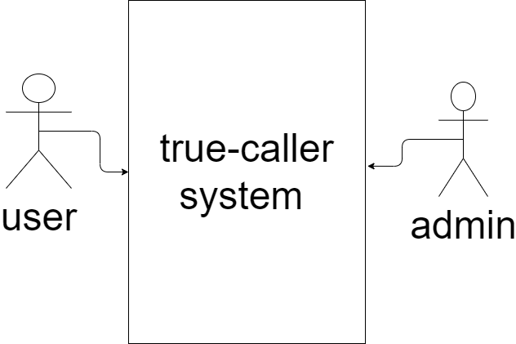
2.1.System Environment
• The Intelligent true caller System is a web system that has two main actors.
• Users and Admins can use the system through a website based on the internet and it using the online database.
• The admin has the accesses the entire system and modify on the online database directly but user can only use the features of the system without modify its installation

Slide 51
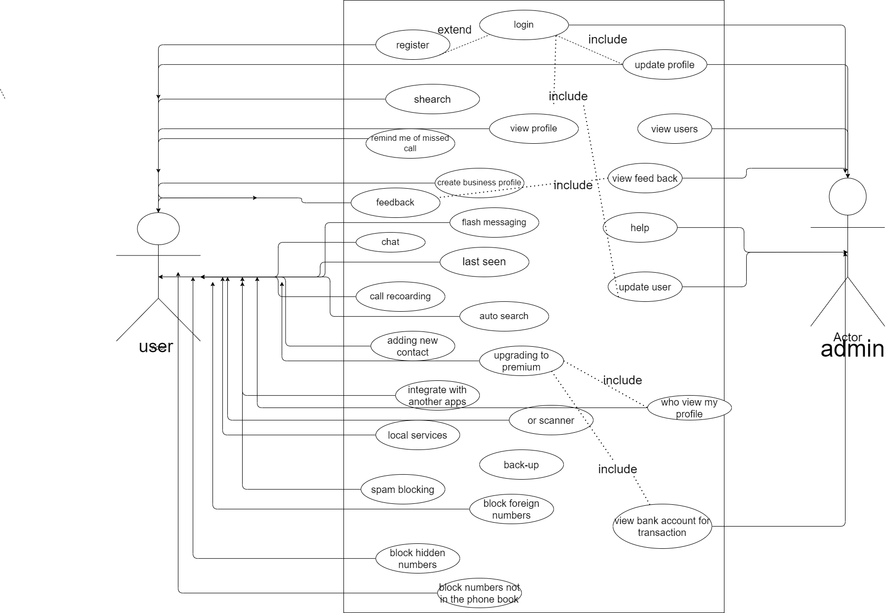
Functional REQs Specifications:
2.2.True-caller System Use Case

Slide 52
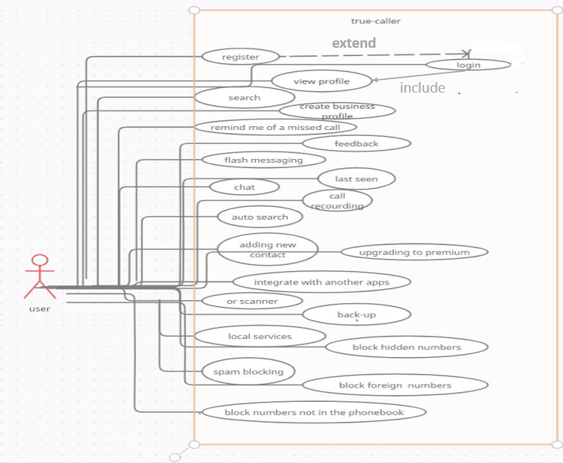
2.2.1.User use case

Slide 53
Use Case : registration
Initiator: | user
Goal: | the new users can register a new profiles in the system to benefit from the features of it.
Pre-Conditions: | None.
Post-Conditions: | the user is successfully registered in the system and the user will get a screen of login and Now he/she can login in the system with his/her username and password.
Description: | This login function describe how a user can log into the system using username and password and the system compares between the data sent by user and the existing data stored in the online database.

Slide 54
Success scenario: | Note: the entered Username by the user is not as the existing usernames in the online database 1- the user fills the (Username, Password, Confirm Password, First Name , Last Name) labels successfully. 2- the user chooses the Gender (female or men) 3- the user chooses Age 4- the user clicks on the register button 5- the user has registered a new user successfully.
Unsuccess scenario: | 1- the user enter numbers in the (First Name , Last Name) fields 1.1- the system show message below the field "only letters". 2- the user enters password in (Confirm Password) field doesn't match the password in (password) field. 2.1- the system show message below the field "invalid password“ 3- the user enter an used email. 3.1- the system show message below the field "used email" 4- the user doesn't fill field or click on the "register" button without fill the fields. 4.1- the system show message below the empty field "required ". 5- the user enter used username. 5.1- the system show message below the field “used username”.

Slide 55
Use Case : login
Initiator: | user
Goal: | The user login to the system to access different benefits of it.
Pre-Conditions: | User must connect to the internet and registered previously in the system and enter his/her data (username, password) correctly.
Post-Conditions: | If the login use case was successful, the actor (user) is now logged into the system. If not the system will display login error and the user will get a screen with 2 tabs
Description: | the user can access the Intelligent Tourist System by register in the system using (Username, Password, E mail, First name, Last name, Gender, Age) and the system compares between the username sent by user and the existing usernames stored in the online database.

Slide 56
Success scenario: | Note: the entered Username by the user is not as the existing usernames in the online database 1- the user fills the (Username, Password, Confirm Password, First Name , Last Name) labels successfully. 2- the user chooses the Gender (female or men) 3- the user chooses Age 4- the user clicks on the register button 5- the user has registered a new user successfully.
Unsuccess scenario: | 1- the admin enters his/her information wrong: Note: the entered data by the admin is not as the existing data in the online database 1.1- the admin enters wrong “username “. 1.1.1- the admin enter correct “password” exist in the database. 1.1.2- the admin clicks on “login” button. 1.1.3- the system shows a message “invalid username or password “. 1.2- the admin enters wrong “password” only. 1.2.1- the admin enters correct “username” exist in the database. 1.2.2- the admin clicks on “login” button. 1.2.3- the system shows a message “invalid username or password “. 1.3- the admin enters both the “password” and “username” wrong. 1.3.1- the admin click on “the login button. 1.3.2- the system shows a message “invalid username or password”. 1.4- the admin doesn’t fill his/her “username” and “password” label. 1.4.1- the system shows a message “enter your username and password “.

Slide 57
Use Case : View profile
Initiator: | user
Goal: | The user can access his/her data
Pre-Conditions: | the user must be registered and logged on the system.
Post-Conditions: | The user can view his/her data (Username, Password, E-mail, First name, Last name, Gender, Age).
Description: | The user can view his/her data (Username, Password, E-mail, First name, Last name, Gender, Age) by retrieving it from the online database for the username just logged in

Slide 58
Success scenario: | 1.the user login the system. 2.Clicking on “ view profile ” in the homepage. 3.Access the data of the logged in user on the system
Unsuccess scenario: | 1. the user not logged in the system. 1.2-the system show message that you have to login or register in first

Slide 59
Use Case : Write Feedback
Initiator: | user
Goal: | Send feedback of the experience to help the system and admin to adjust their behaviour and/or improve their performance or inform a complaint.
Pre-Conditions: | the user must be registered and logged on the system.
Post-Conditions: | An message appears that “your feedback is sent successfully”
Description: | Users can give their feedback about the system by rating it from one to ten and leave a comment to explain the advantages and disadvantages of the system

Slide 60
Success scenario: | 1.The user logged in to the system. 2.Click on “Write your Feedback” in the bottom of the homepage. 3.write the feedback text 4.click on “send the Feedback” button.
Unsuccess scenario: | 1- the user doesn't fill the field and click on the “Send the feedback" button without fill the fields. 1.1- the system show message below the empty field "required ". 2- the user not logged in the system. 2.1- the system show message that you have to log or register in first

Slide 61
Use Case : Manual search
Initiator: | user
Goal: | the user make a manual search for a specific no. or name
Pre-Conditions: | the user must be registered and logged on the system choose the Manual search Tab.
Post-Conditions: | Based on the requirements provided by the user, he/she can view the no. or name he/she searched about it.
Description: | this function help user to get information about other user by searching with the name or the phone number

Slide 62
Success scenario: | 1.the user have been logged to the system 2.the user click on the “Manual Tab" button on home page 3- the user write the number or the name of person he/she wanted 4.this use case work and give the user also the option to view and to know information about what he /she wanted
Unsuccess scenario: | 1-the user have been logged to the system 1.1- have a failure problem in system (step 1). 2- the user not logged in the system. 2.2-the system show message that you have to login first 3- it lead to database failure or message "error restart again“ 3.1- the user click on the “Manual Search" label 3.2- the user write the number or the name he/she wanted 3.3- have a database problem or the algorithm doesn't work

Slide 63
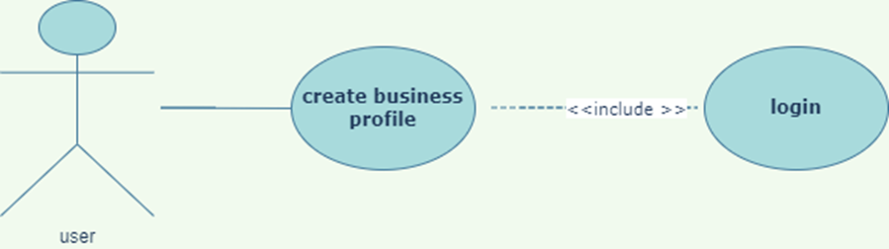
Use Case : create business profile
Initiator: | User
Goal: | it enriches the user experience for calls from Verified Businesses by adding elements that project Trust & Safety. Represent the Brand accurately.
Pre-Conditions: | the user must be registered and logged on the system and then create the business profile
Post-Conditions: | The user has viewed all the data about that brand
Description: | It allows you to list important information about your company , and its an excellent way to associate with your customers in a more trustworthy way

Slide 64
Success scenario: | 1.the user login the system. 2.Clicking on “create business profile ” in the homepage. 3.Access the data of the logged in user on the system 4- Business profile is created successfully.
Unsuccess scenario: | 1. the user not logged in the system. 1.1-the system show message that you have to login or register in first

Slide 65
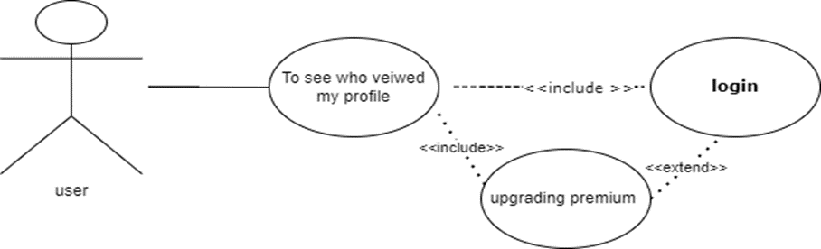
Use Case : To see who viewed your profile
Initiator: | User
Goal: | To see who viewed your profile
Pre-Conditions: | the user must be registered and logged on the system and upgrade to premium
Post-Conditions: | The user will be able to know information about who viewed his / her profile
Description: | It is used to see who viewed your profile

Slide 66
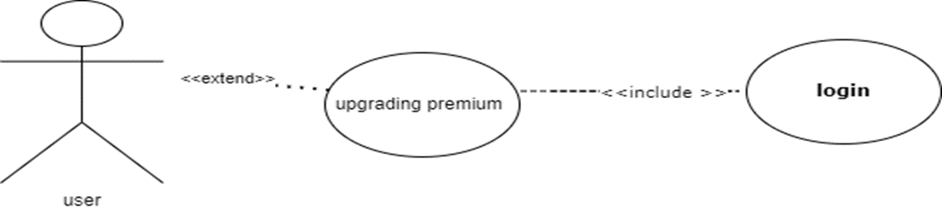
Use Case :upgrading to premium
Initiator: | User
Goal: | Premium version helps you in doing more with their service, See who saw your Profile .You can see the number of minutes ago somebody saw your profile!
Pre-Conditions: | the user must be registered and logged on the system
Post-Conditions: | The user will have more services in the app that will help them
Description: | You can get call recording , incognito mode of viewing and no ads features and get flash massaging

Slide 67
Success scenario: | 1.the user login the system. 2. The user must pay for the app PREMIUM first . 3. click on who viewed my profile in the navigation area of app.
Unsuccess scenario: | 1. the user not logged in the system. 3.1-the system show message that you have to login or register in first 3.2- the system show message that you have to pay first

Slide 68
Success scenario: | 1.the user login the system. 2. The user must pay for PREMIUM first . 3. The user will be able to use the premium.
Unsuccess scenario: | 1-the user have been logged to the system 1.1- have a failure problem in system (step 1). 2.2-the system show message that you have to login first 3- it lead to database failure or message "error restart again“

Slide 69
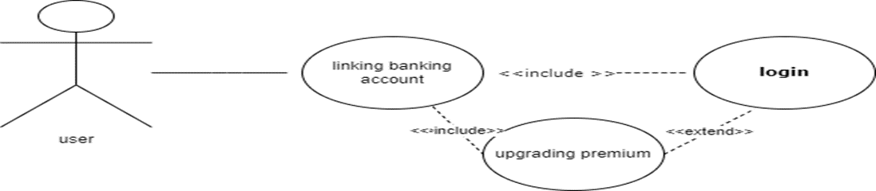
Use Case : linking bank account
Initiator: | User
Goal: | makes it possible to conduct transactions between the user and the bank electronically for the payment.
Pre-Conditions: | the user must be registered and logged on the system and upgrading premium
Post-Conditions: | The BANK ACCOUNT is successfully done
Description: | Used to do UPI transactions by app pay

Slide 70
Success scenario: | 1.the user login the system. 2. The user must pay for PREMIUM first . 3. The bank account is successfully done.
Unsuccess scenario: | 1-the user have been logged to the system 1.1- have a failure problem in system (step 1). 1.1.2-the system show message that you have to login first 3- it led to database failure or message "error restart again“

Slide 71
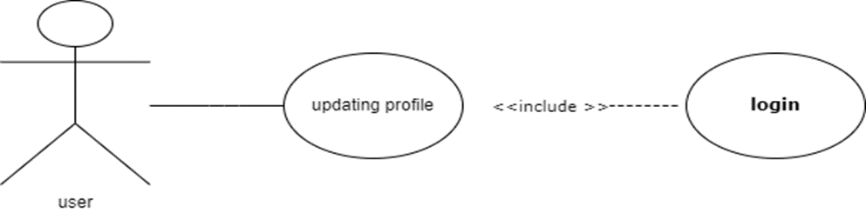
Use Case : Update profile
Initiator: | User
Goal: | The user can update his/her profile.
Pre-Conditions: | the user must be registered and logged on the system.
Post-Conditions: | The user can update his/her data (Username, Password, E-mail, First name, Last name, Gender, Age)and profile.
Description: | Visible to persons who view your profile.

Slide 72
Success scenario: | 1.the user login the system. 2.Clicking on “Profile Info” in the homepage. 3.clicking on “update the info” in the profile page 4.Access the data of user on the system 5.update any data of the user on the online database in the system
Unsuccess scenario: | 1-the user have been logged to the system 1.1- have a failure problem in system (step 1). 1.1.2-the system show message that you have to login first 3- it led to database failure or message "error restart again“

Slide 73
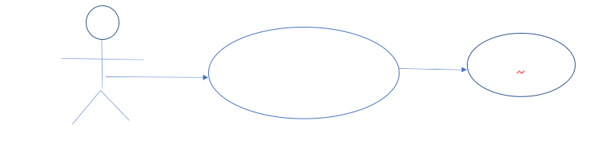
Use Case :Flash Messaging
Flash Messaging
login
include
Initiator: | User
Goal: | Send pictures through a flash message Chat quickly with friends and family Share your location.
Pre-Conditions: | the user must be registered and logged on the system
Post-Conditions: | The message will be sent
Description: | The flash message will be shown only for 60 seconds then leave a short message in the notification tray which you can tap on to read and reply later.

Slide 74
Success scenario: | 1.the user have been logged to the system 2.the user scrolled through your contacts or search a number and select one 3. the user tapped on the icon of Flash Messaging 4.the user Typed in his/her Message 5. the message has been sent successfully
Unsuccess scenario: | 1-the user have been logged to the system 1.1- have a failure problem in system (step 1). 1.1.the user was not connected to the internet 1.1.2.the message has not been delivered to the contact 1.1.the other contact does not have an account on the system 1.1.2. the receiver could not receive the message

Slide 75
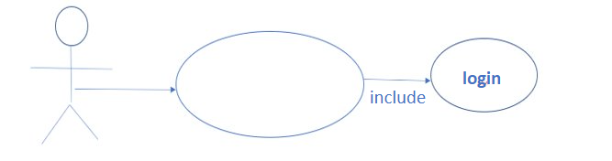
Use Case :chat
chat
Initiator: | User
Goal: | ​integration between SMS and chat
Pre-Conditions: | ​1.the user must be registered and logged on the system 2.strong data/Wi Fi connection 3.full media support
Post-Conditions: | ​ send message to family and friends
Description: | The messages sent between True caller users will be handled in the for free, while messages sent to non-users will go over as SMS, which is ported by the app.

Slide 76
Success scenario: | 1.the user have been logged to the system 2. the user scrolled through his/her contacts or search a number 3.the user selected one 4.the user Typed in his/her Message 5.the user choose sent icon 6. the message has been sent successfully
Unsuccess scenario: | 1-the user have been logged to the system 1.1- have a failure problem in system (step 1). 1.1.the user was not connected to the internet 1.1.2.the message has not been delivered to the contact 1.1.the other contact does not have an account on the system 1.1.2. the receiver can not receive the message 1.1.the user The user has not given the system all permissions to access the full media

Slide 77
Use Case last seen
Last seen(Availability)
Initiator: | User
Goal: | know if the person you're about to call is busy or not.
Pre-Conditions: | the user must be registered and logged on the system
Post-Conditions: | Knowing the state of other contacts
Description: | if you see a red bell icon next to that number it means that phone is on silent mode. If you see a red phone icon, it means that person is on the phone. You can also see the last time a user was active in the app through the ‘Last Seen‘ time displayed

Slide 78
Success scenario: | 1.the user have been logged to the system 2.the user saw the last seen of its contact 3.the user would see the state of its contact
Unsuccess scenario: | 1-the user have been logged to the system 1.1- have a failure problem in system (step 1). 1.1.the other contact does not have an account on the system 1.1.2.the user would not know the last seen of the contact

Slide 79
Use Case :ADDING NEW CONTACTS
ADDING NEW CONTACTS
Initiator: | User
Goal: | ​ adding contacts to phonebook
Pre-Conditions: | ​the user must be registered and logged on the system
Post-Conditions: | ​the user add contacts to his/her phonebook
Description: | the user can add any contact to his/her phonebook using the system without any need to The phone dialer

Slide 80
Success scenario: | 1.the user have been logged to the system 2.the user selected add contact to phonebook icon on navigation bar 3.the user entered details of the new contact. 4.the user pressed save
Unsuccess scenario: | 1-the user have been logged to the system 1.1- have a failure problem in system (step 1). 1.1.the contact has been added before 1.1.there is another contact have the same details 1.1. the user contact list is full

Slide 81
Use Case :View Bank Account For Transactions​
View Bank Account For Transactions​
View Bank Account For Transactions​
login
include
Initiator: | admin
Goal: | Used to do UPI transactions by true caller pay.​
Pre-Conditions: | the user must be registered and logged on the system
Post-Conditions: | The message will be sent
Description: | It is a function that allows the administrator to access the bank account used and know the account data so that he can pay to true caller​

Slide 82
Success scenario: | 1.the user have been logged to the system 2. The user enters his bank account information 3.The administrator sends a request to the bank that identifies the user account and is the data correct 4. The bank contacts the official and confirms the existence of an account using a message. This is how the payment is made
Unsuccess scenario: | 1-the user have been logged to the system -2The user does not enter his bank account information -3The administrator does not send a request to the bank Specifies an account -4The requests are not verified User's bank account The data is not confirmed by the bank -5 The bank did not contact the office and confirm the existence of an account in the message. non-payment

Slide 83

Use Case: Remind me of a missed call include
View
include
Remind me of a missed call
Initiator: | User
Goal: | Function that informs the user with missed calls​​
Pre-Conditions: | name or number data is found on database.​​​
Post-Conditions: | A message is sent to the user with the other user's data​​
Description: | It is a function that sends a message to the user knowing the missed calls and the name of the person who made the call if he was not one of the contacts.​​

Slide 84
Unsuccess scenario:
1- The user is logged into the system
1.1- You have a system failure issue (Step 1).
2- The user is not logged into the system.
2.2-The system shows a message that you must log in first
3- It causes the database to fail or the message “Error restarting again” appears.
-4No missed call message or answered call is sent
Success scenario: | 1-the user have been logged to the system 2-After the user opens the site, the site will display the missed calls
Unsuccess scenario: | 1-the user has been logged into the system 1.1- have a failure problem in the system (step 1). 2- the user is not logged in to the system. 2.2-the system show message that you have to log in first 3- it leads to database failure or the message “error restart again” 4-missed call message or answered call is sent

Slide 85
Use Case :View Calls
View Calls
Initiator: | User
Goal: | Show user calls made or received
Pre-Conditions: | The user must be logged into the system(name and number data is found on database).​​
Post-Conditions: | ​User can see incoming and outgoing calls
Description: | It is a function that allows the user to know the numbers and calls (outgoing and incoming) by retrieving them from the online database for the username.

Slide 86
Success scenario: | 1. The admin is logged into the system. 2. User clicks "View Calls" button 3. the user scrolled through his/her contacts or search a number 4. Access to calls in the system and shown to the user.
Unsuccess scenario: | 1- The administrator is logged into the system 1.1- You have a system failure issue (Step 1). 2- The administrator is not logged into the system. 2.2-The system shows a message that you must log in first 3- It causes the database to fail or the message “Error restarting again” appears. 4-The history of calls made or received by the user is not shown.

Slide 87
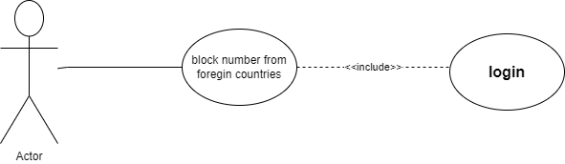
BLOCKING NUMBERS FROM FOREIGN COUNTRIES:
Function name | BLOCKING NUMBERS FROM FOREIGN COUNTRIES
Actor | User
Goal | Only numbers from your country will be able to call you
Pre- conditions | the user must be registered and logged on the system and go to manage blocking settings
Post-conditions | The user will receive call from inside the country only
Description | The user will not receive any call from another country and this is an optional service

Slide 88
Success scenario: | 1.the user login the system. 2-go to manage blocking settings 3- tap on block numbers not in same country. 4- blocked successfully
Unsuccess scenario: | 1. the user not logged in the system. 1.2-the system show message that you have to login or register in first 2-user login failed due to internet or server error . 2.1- the app crushed due to errors. 3- user failed to block the number. 4-user blocked the wrong number

Slide 89
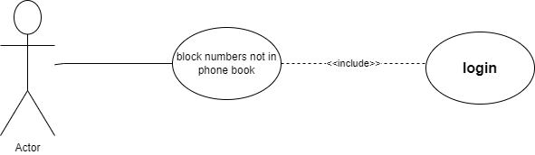
BLOCK NUMBERS NOT IN THE PHONEBOOK:
Function name | BLOCK NUMBERS NOT IN THE PHONEBOOK
Actor | User
Goal | Not everyone can call the user only the people in his /her phonebook
Pre- conditions | the user must be registered and logged on the system and go to manage blocking settings
Post-conditions | The user will receive only calls from people in his /her phonebook
Description | Only people in your phonebook will be able to call you

Slide 90
Success scenario: | 1.the user login the system. 2-go to manage blocking settings 3- tap on block numbers not in phonebook. 4- blocked successfully
Unsuccess scenario: | 1. the user not logged in the system. 1.2-the system show message that you have to login or register in first 2-user login failed due to internet or server error . 2.1- the app crushed due to errors. 3- user failed to block the number. 4-user blocked the wrong number

Slide 91
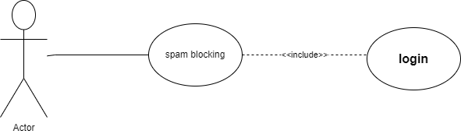
Spam blocking
Function name | Spam blocking
Actor | User
Goal | it helps the user to avoid Fraud or criminal activity Abusive or obscene calls (to anyone but especially women) Crank calls Unsolicited telemarketing calls Robocalls Phone spam Scams (like pyramid schemes, tech-support scams, impersonation of financial institutions)
Pre- conditions | The user must be registered and logged on the system and go to manage blocking settings
Post-conditions | The user will not receive call from spammers
Description | It is used to protect yourself from calls and messages from most reported numbers.

Slide 92
Success scenario: | 1.the user login the system. 2-go to manage blocking settings 3-tap on block top spammers 4- blocked successfully
Unsuccess scenario: | 1. the user not logged in the system. 1.2-the system show message that you have to login or register in first 2-user login failed due to internet or server error . 2.1- the app crushed due to errors. 3- user failed to block the number. 4-user blocked the wrong number

Slide 93
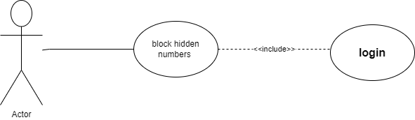
Block hidden numbers
Function name | Block hidden numbers
Actor | User
Goal | Used block any number that is shown as unknown or private.
Pre- conditions | The user must be registered and logged on the system and go to manage blocking settings
Post-conditions | The user will not receive calls from unknown numbers .
Description | A hidden number can also be known as a 'private number' - or any call that rings through, but does not show the number. this app reviews incoming calls, and can be set to reject all unknown calls and private numbers .

Slide 94
Success scenario: | 1.the user login the system. 2-go to manage blocking settings 3- tap on block hidden numbers . 4- blocked successfully
Unsuccess scenario: | 1. the user not logged in the system. 1.2-the system show message that you have to login or register in first 2-user login failed due to internet or server error . 2.1- the app crushed due to errors. 3- user failed to block the number. 4-user blocked the wrong number

Slide 95
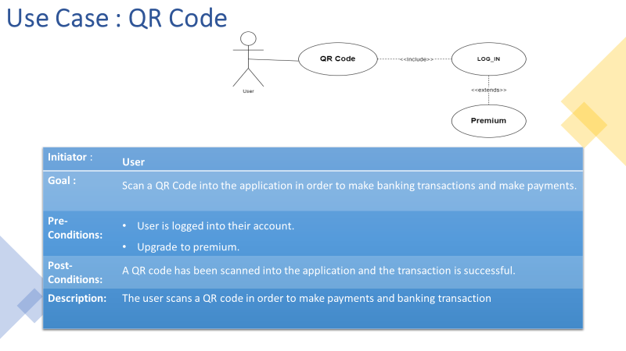

Slide 96
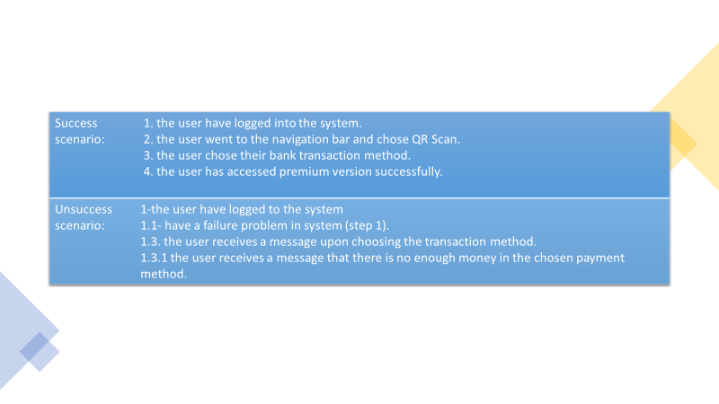

Slide 97
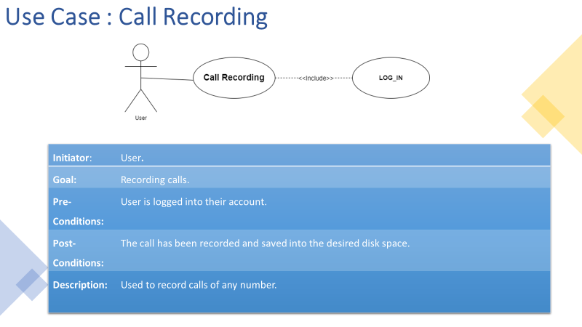

Slide 98
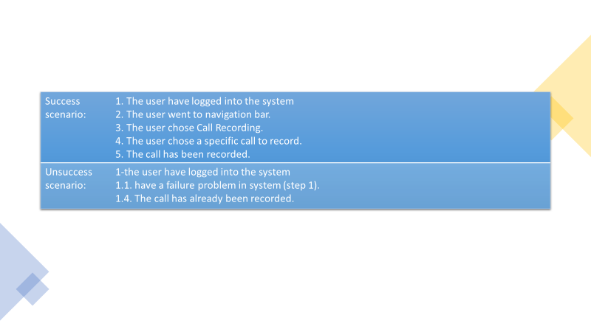

Slide 99
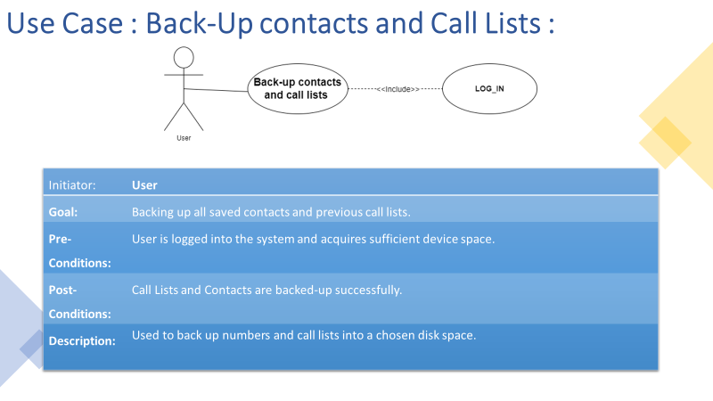

Slide 100
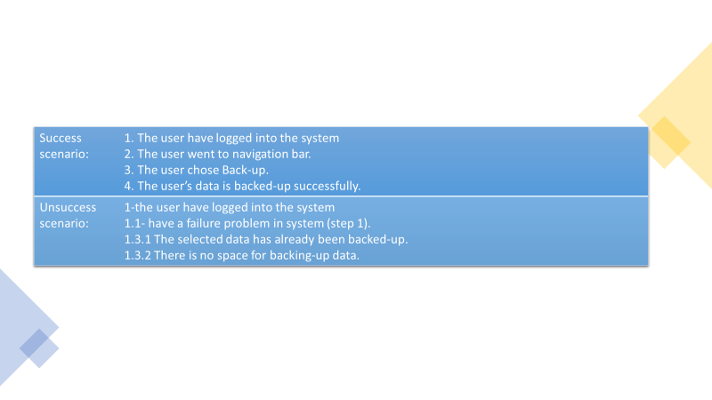

Slide 101
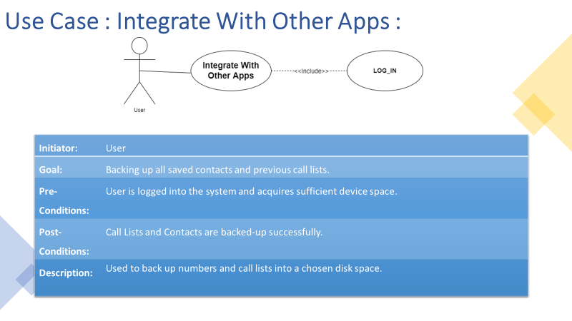

Slide 102
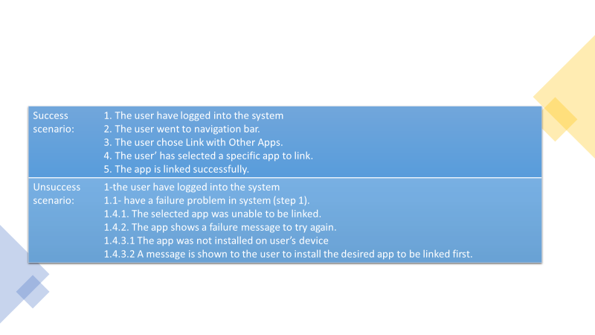

Slide 103
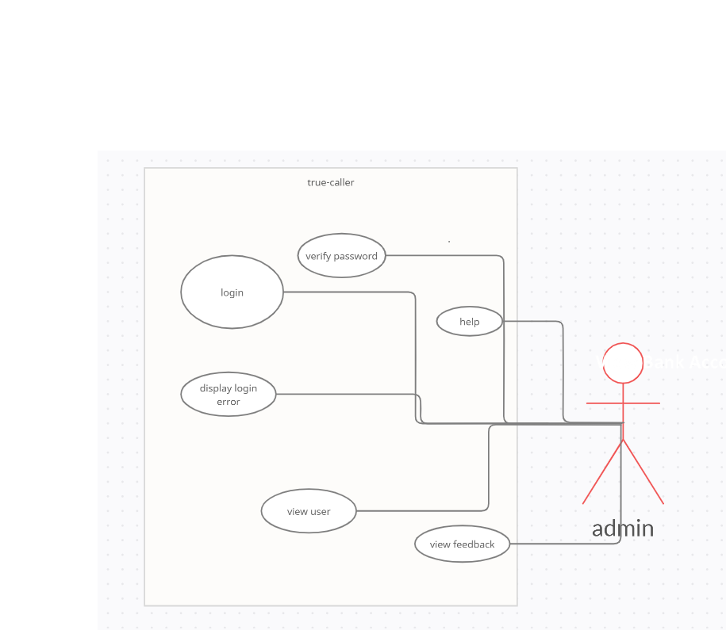
2.2.2.Admin use case

Slide 104
Use Case :login
EXTEND
EXTEND
Display login error
Verify password
Log in
include
Initiator: | admin
Goal: | The admin login to the system to control the System​
Pre-Conditions: | None
Post-Conditions: | the login use case was successful, the actor (admin) is now logged into the system and the admin gets a screen with Admin Dashboard. ​
Description: | This login function describes how an admin can log in to the system using a username and password private and the system compares the data sent by the user and the existing data stored in the online database. Function Name View places Actors Admin Goal The admin View places the system in the online database.​

Slide 105
Success scenario: | Note: the entered data by the admin must be as the existing data in the online database 1- the admin fills the “username” label correctly. 2- the admin fills the “password” label correctly. 3- the admin clicks on the “login” button. 4- the admin will be connected to the system successfully.
Unsuccess scenario: | Note: the entered data by the admin is not as the existing data in the online database 1.1- the admin enters wrong “username “. 1.1.1-the admin enter correct “password” exist in the database. 1.1.2- the admin clicks on “login” button. 1.1.3- the system shows a message “invalid username or password “. 1.2- the admin enters wrong “password” only. 1.2.1- the admin enters correct “username” exist in the database. 1.2.2- the admin clicks on “login” button. 1.2.3- the system shows a message “invalid username or password “. 1.3- the admin enters both the “password” and “username” wrong. 1.3.1-the admin click on “the login button. 1.3.2- the system shows a message “invalid username or password”. 1.4- the admin doesn’t fill his/her “username” and “password” label. 1.4.1- the system shows a message “enter your username and password “

Slide 106
Use Case :View Feedback
View feedback
Initiator: | admin
Goal: | Access the feedbacks written by users in the system​
Pre-Conditions: | The Admin must logged in the system.​
Post-Conditions: | The feedback will be viewed by the admin.​
Description: | The admin can access the feedback of the user stored in the online database and considering their feedback the admin must modify the system to fit with the user’s requirements. ​

Slide 107
Success scenario: | 1.the admin have been logged to the system. 2.the admin click on the “View feedback" button 3. access the questionnaires in the system and it appears to the admin.
Unsuccess scenario: | 1-the admin have been logged to the system 1.1- have a failure problem in system (step 1). 2- the admin not logged in the system. 2.2-the system show message that you have to login first 3- it lead to database failure or message "error restart again“

Slide 108
Use Case :Help
Help
Initiator: | Admin
Goal: | Solve problems that guide the user in the system​
Pre-Conditions: | The user sends the problem to the admin, or the process that is difficult to perform​
Post-Conditions: | That the administrator solves the problem facing the user​
Description: | It is a function that helps the user to obtain the best system service and to report any problem or malfunction the user faces in the system.​

Slide 109
Success scenario: | 1.the admin login the system. 2.Clicking on “Questions and problems” in the homepage. 3. Solve the problem that directs the user. The administrator sends the used solution.
Unsuccess scenario: | 1- the admin not logged in the system. 1.2-the system show message that you have to login first. 2-the admin doesn't fill the field and click on the “help messages" button without fill the fields. 2.1-the system show message below the empty field "required ". 3-it lead to database failure or message "error restart again“

Slide 110
Use Case :view user
View user
Initiator: | admin
Goal: | The admin can access the data of users.​
Pre-Conditions: | ​the admin must be logged on the system.​
Post-Conditions: | ​The admin can view the user's data (Username, Password, E-mail, First name,​​ Last name, Gender, Age).​
Description: | The admin can view the user's data (Username, Password, E-mail, First name, Last name, Gender, Age) by retrieving it from the online database for the username just logged in.​

Slide 111
Success scenario: | 1.the admin login the system. 2.Clicking on “Users Info” in the homepage. 3.Access the data of the signed up users on the system.
Unsuccess scenario: | 1- the admin not logged in the system. 1.2-the system show message that you have to login first

Slide 112

Use Case :update user
chat
update user
admin
Initiator: | admin
Goal: | The admin can update the data of users.
Pre-Conditions: | The admin must be logged on the system.
Post-Conditions: | ​The admin can view the user's data (Username, Password, E-mail, First name, Last name, Gender, Age).
Description: | The admin can view the user's data (Username, Password, E-mail, First name, Last name, Gender, Age) by retrieving it from the online database for the username just logged in.

Slide 113
Success scenario: | 1.the admin login the system. 2.Clicking on “Users Info” in the homepage. 3.clicking on “update the info” in the user's page 4.Access the data of the signed-up users on the system 5.update any data of the users on the online database in the system
Unsuccess scenario: | 1- the admin not logged in the system. 1.2-the system show message that you have to login first. 2-the admin doesn't fill the field and click on the “update" button without fill the fields. 2.1-the system show message below the empty field "required ".

Slide 114
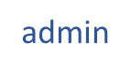
Use Case :delete user
Delete user
Initiator: | admin
Goal: | Delete user
Pre-Conditions: | Delete user
Post-Conditions: | Delete user
Description: | Delete user

Slide 115
Success scenario: | 1.the admin login the system. 2.Clicking on “Users Info” in the homepage. 3.clicking on “Delete the info” in the user's page 4.Access the data of the signed-up users on the system 5.delete any data of the users on the online database in the system .
Unsuccess scenario: | 1- the admin not logged in the system. 1.2-the system show message that you have to login first. 2-the admin doesn't fill the field with the username of user must be deleted and click on the “delete" button without fill the fields. 2.1-the system show message below the empty field "required “.

Slide 116
3.Activity diagram

Slide 117
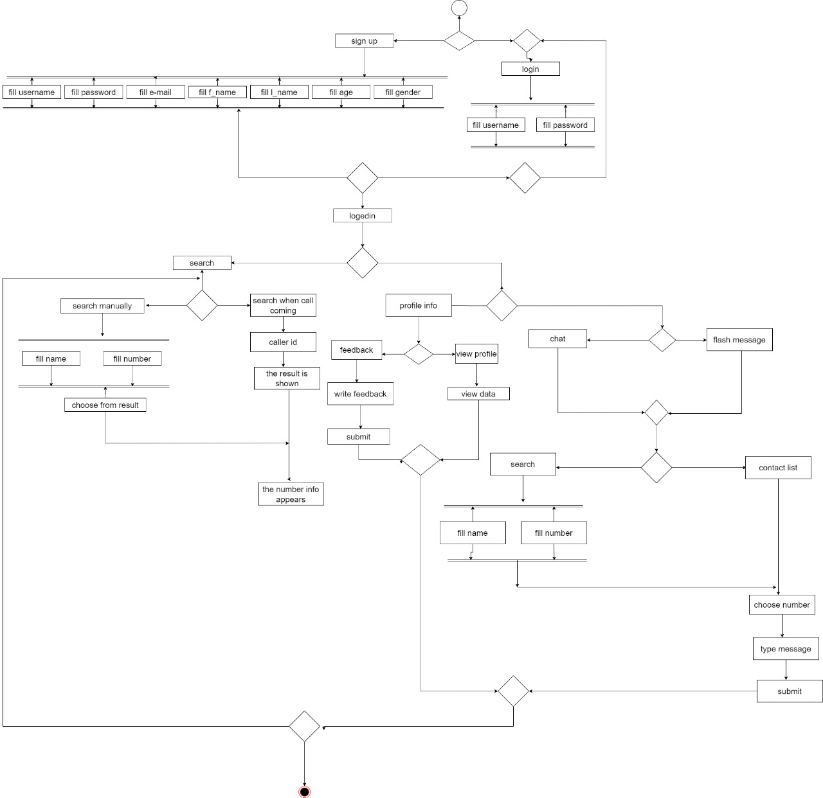
3.1. user Activity diagram

Slide 118
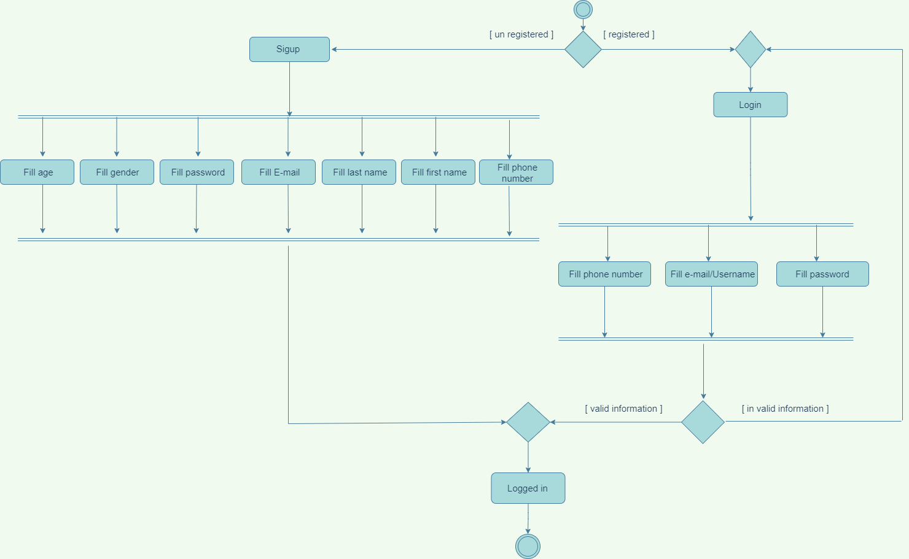
Login &
Registration

Slide 119
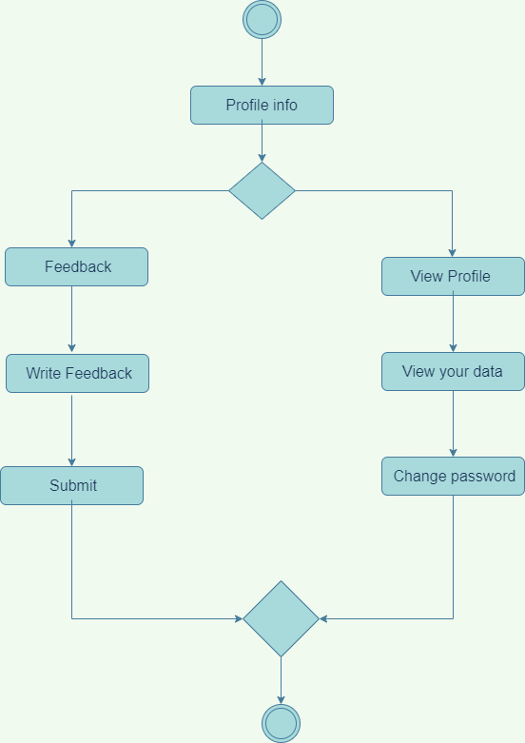
View Profile &
Feedback

Slide 120
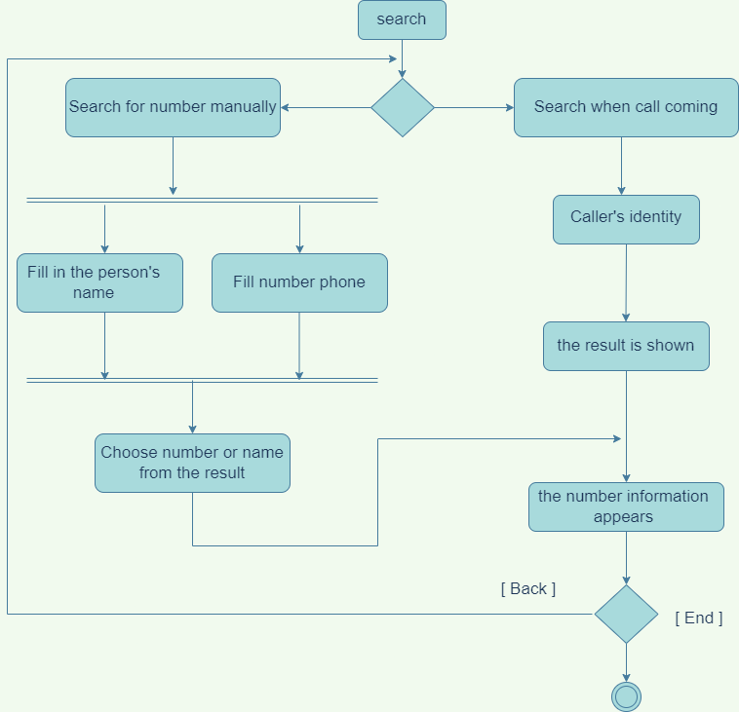
Search

Slide 121
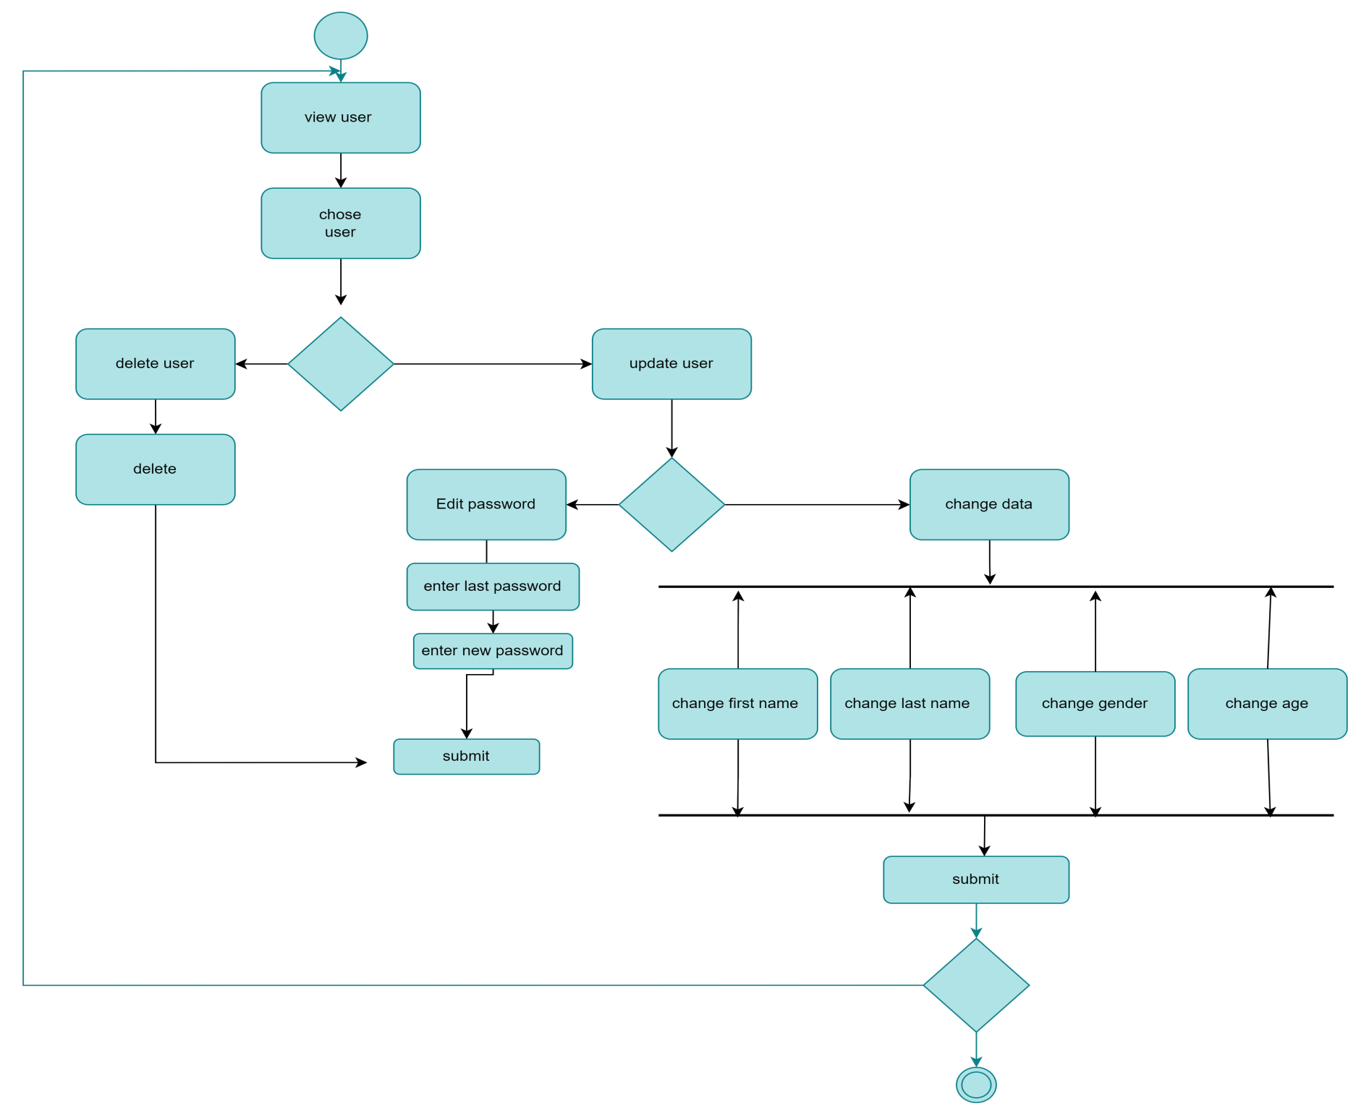
Update User&
Delete User

Slide 122
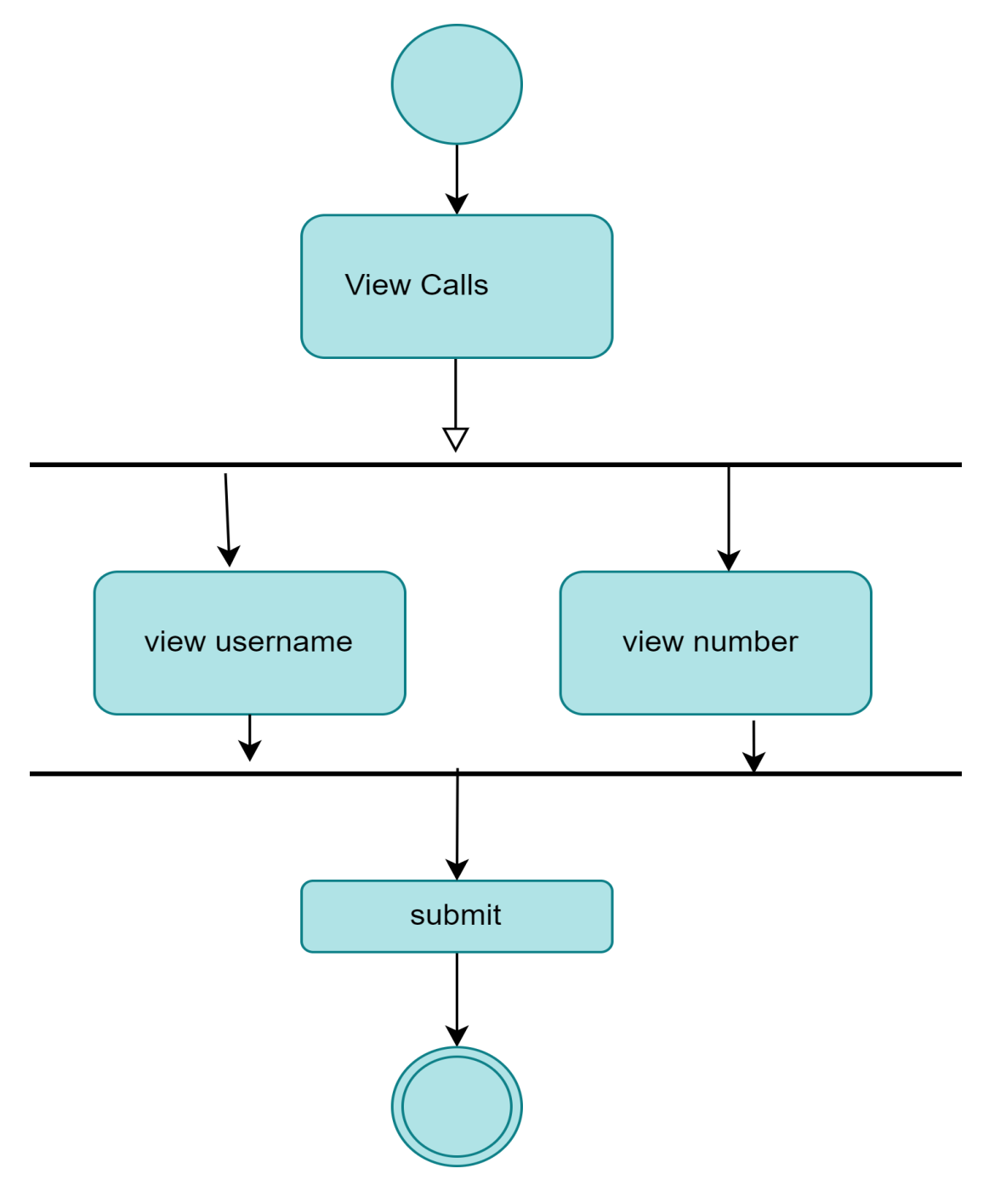
View Calls

Slide 123
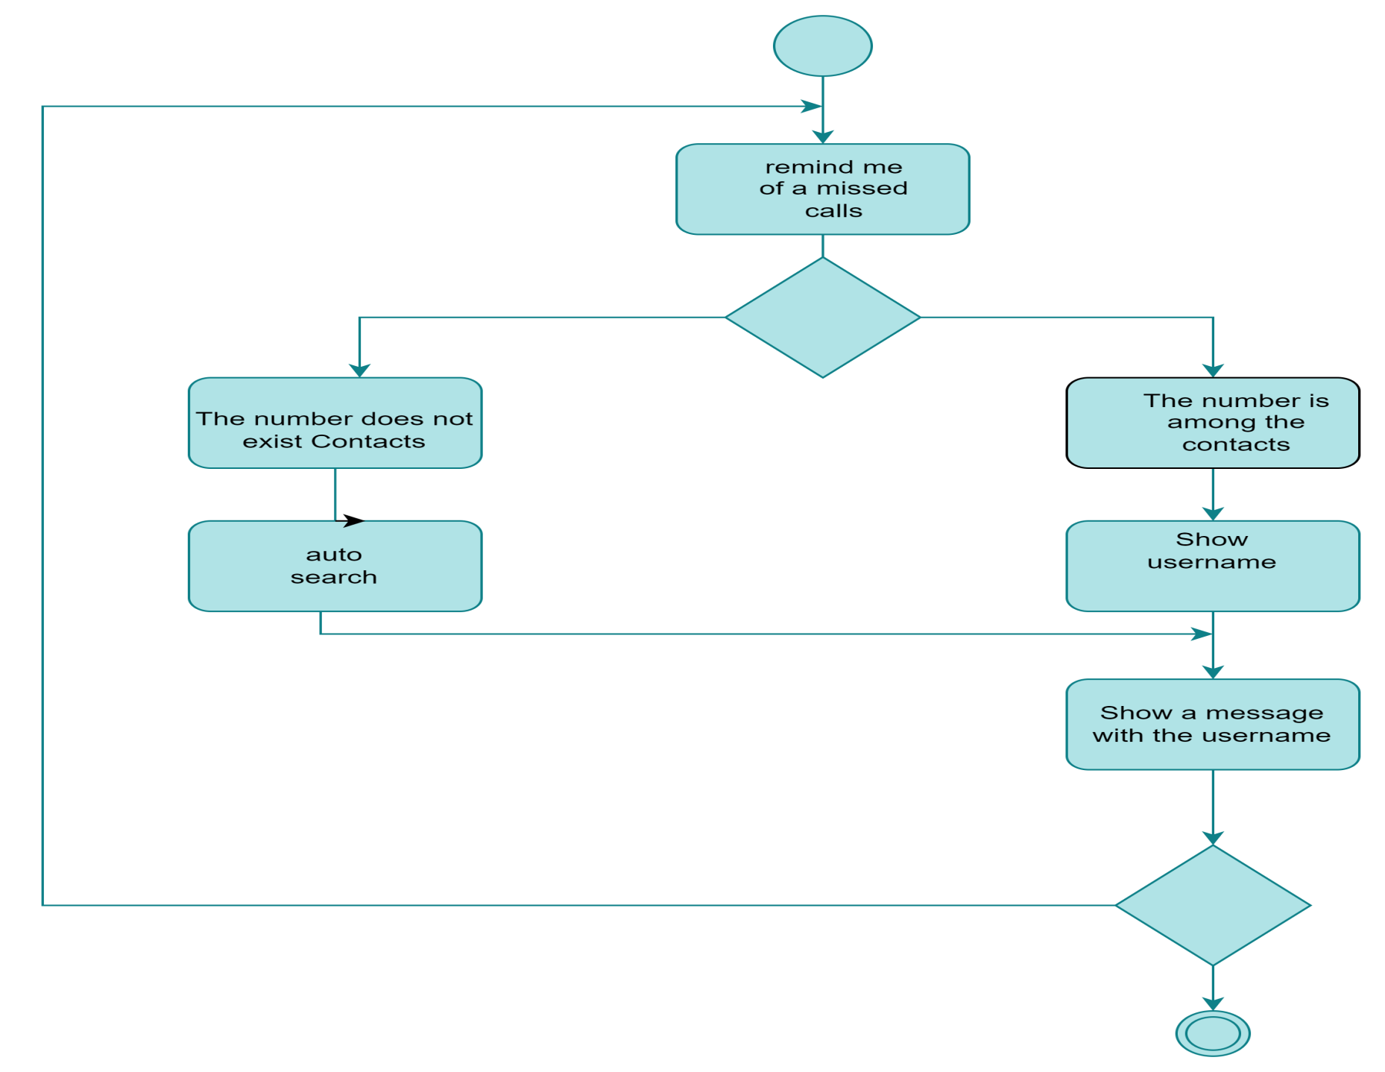
REMIND ME MISSED
CALLS

Slide 124
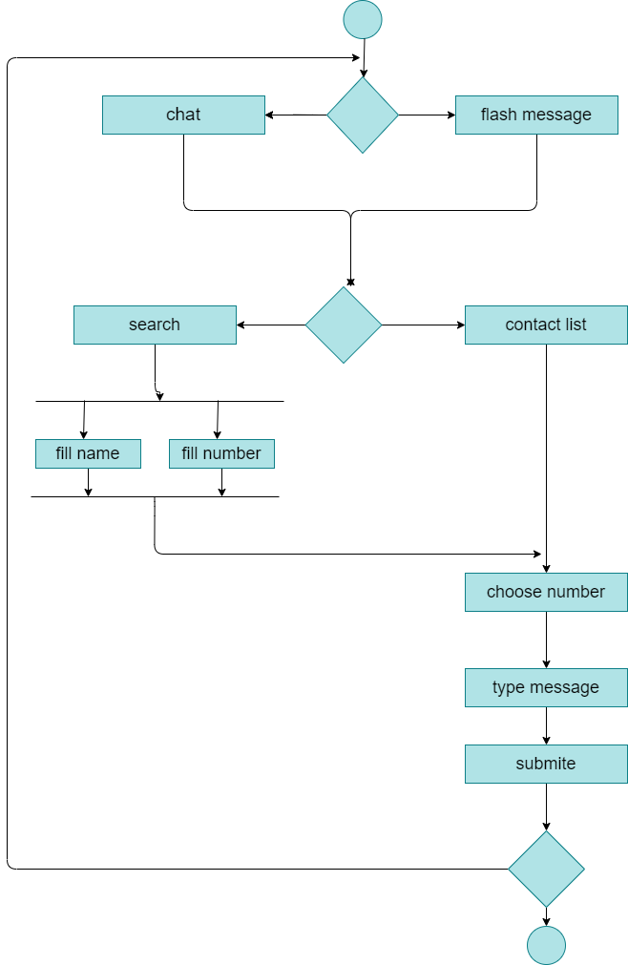
Chat&
Flash message

Slide 125
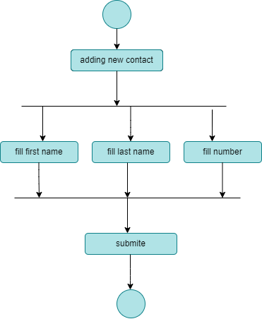
Add
New contact

Slide 126
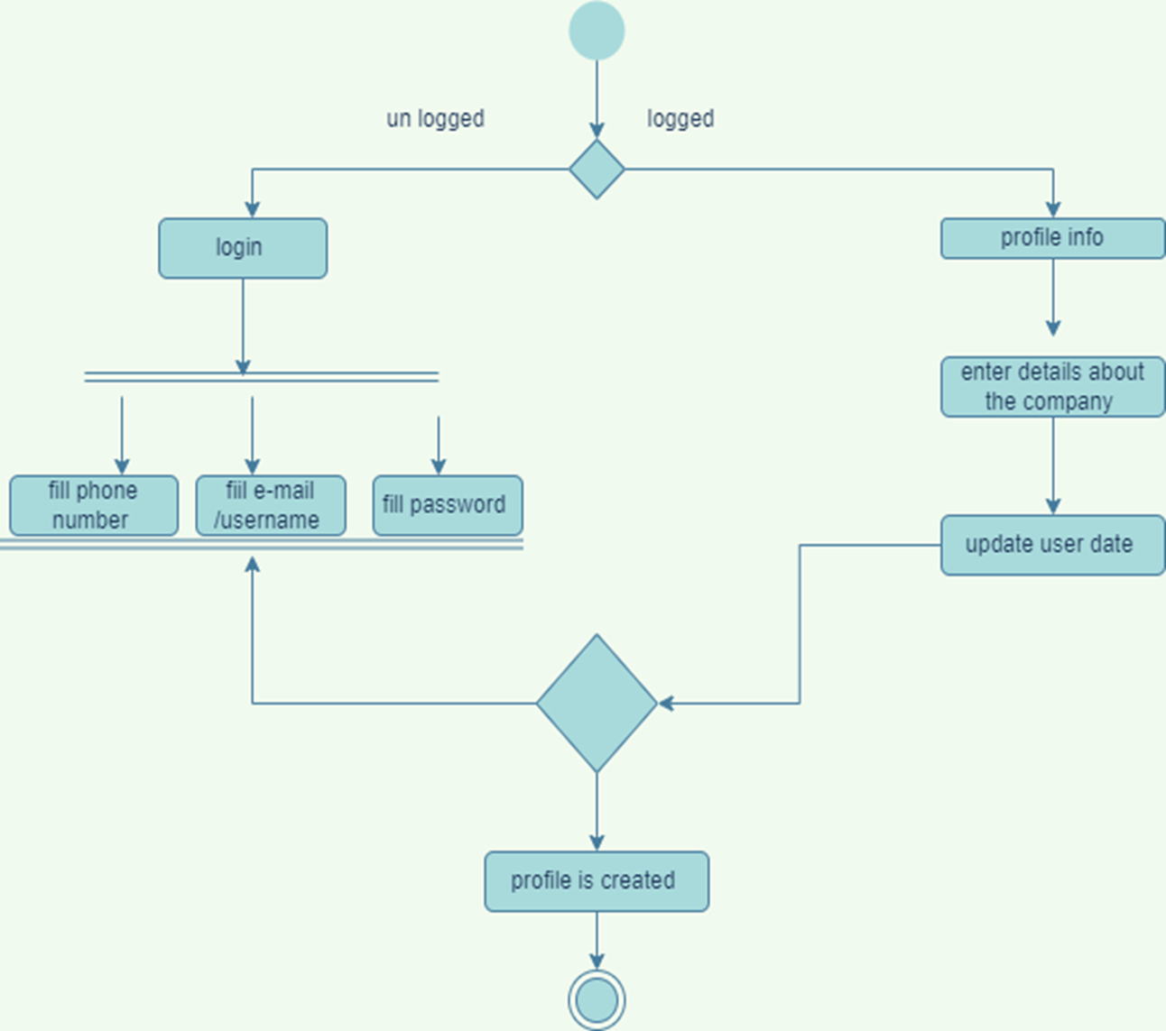
Create
Business
profile

Slide 127
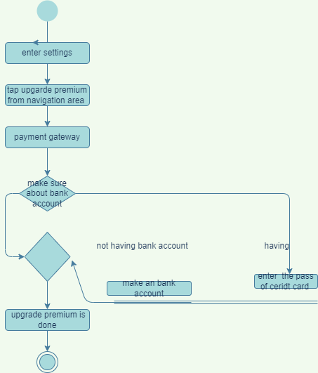
Upgrading
premium

Slide 128
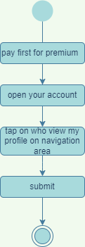
To see who viewed your profile

Slide 129
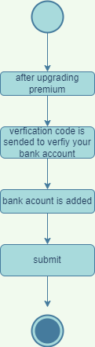
Linking Bank
Account

Slide 130
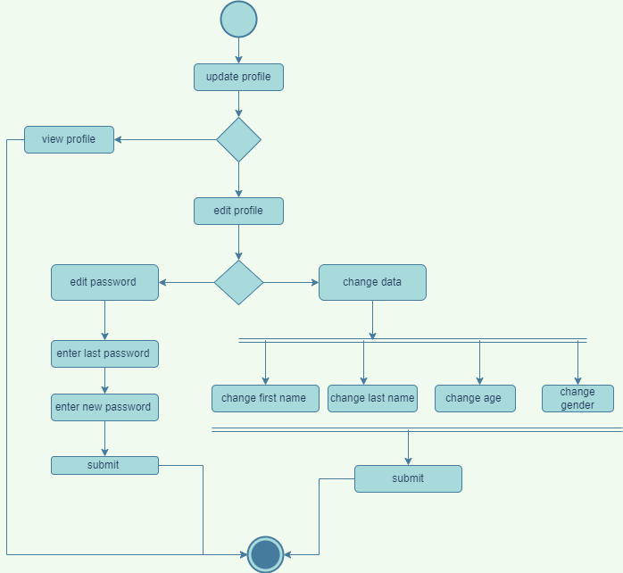
Update profile

Slide 131
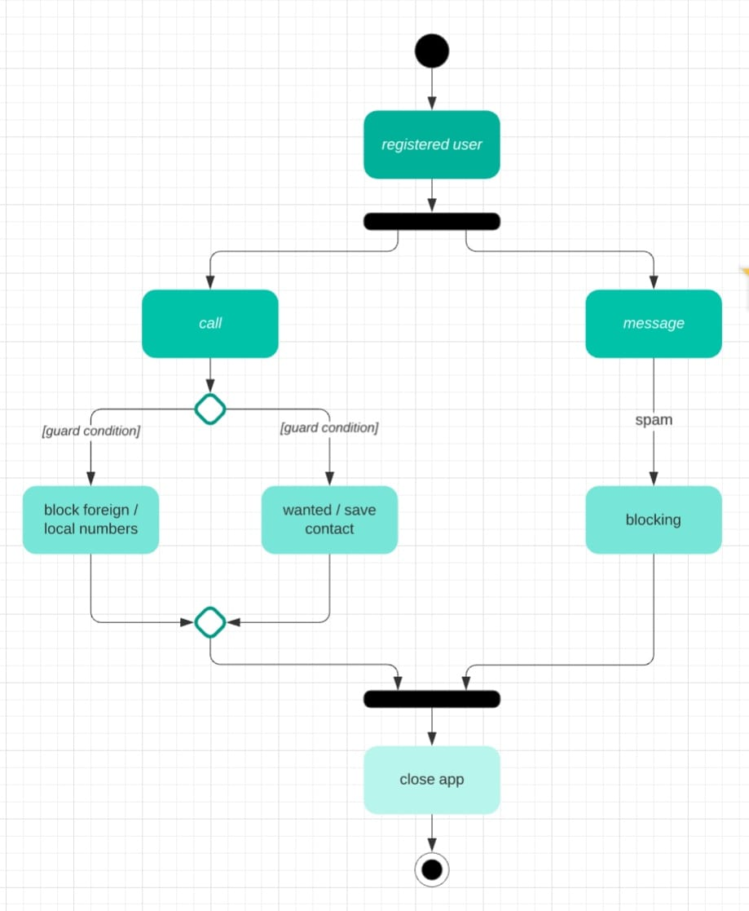
Blocking & spam

Slide 132
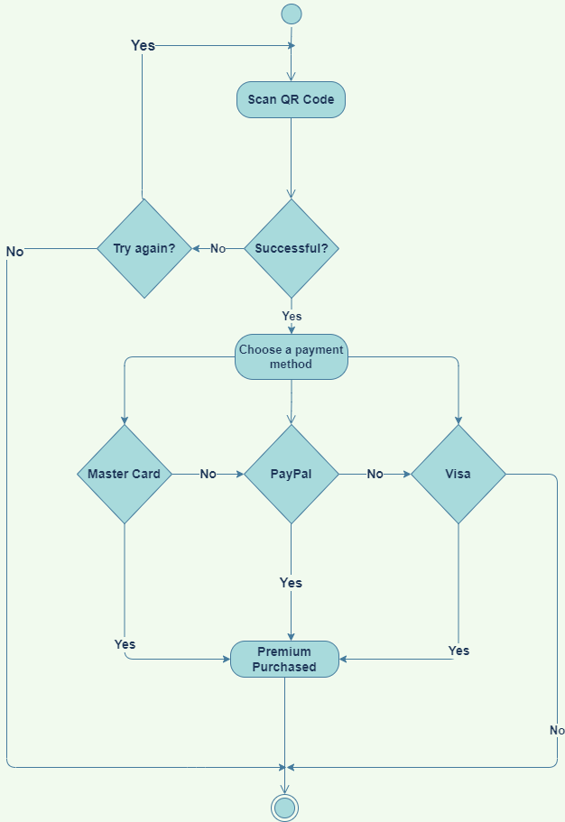
QR Code

Slide 133
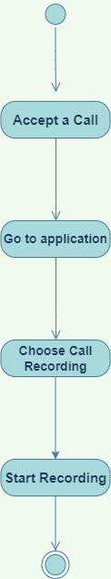
Call Recording

Slide 134
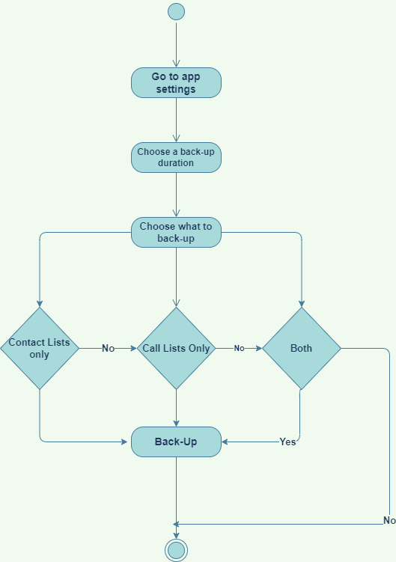
Back-Up Contacts and call lists

Slide 135
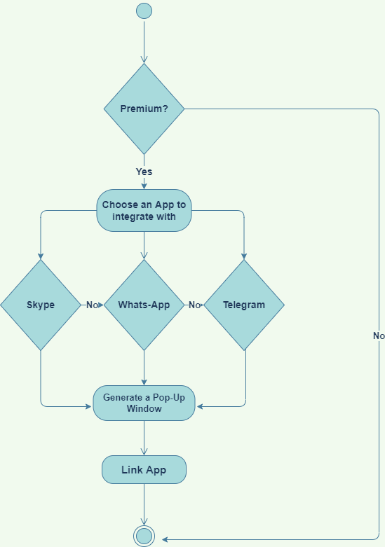
Integrate Other Apps

Slide 136
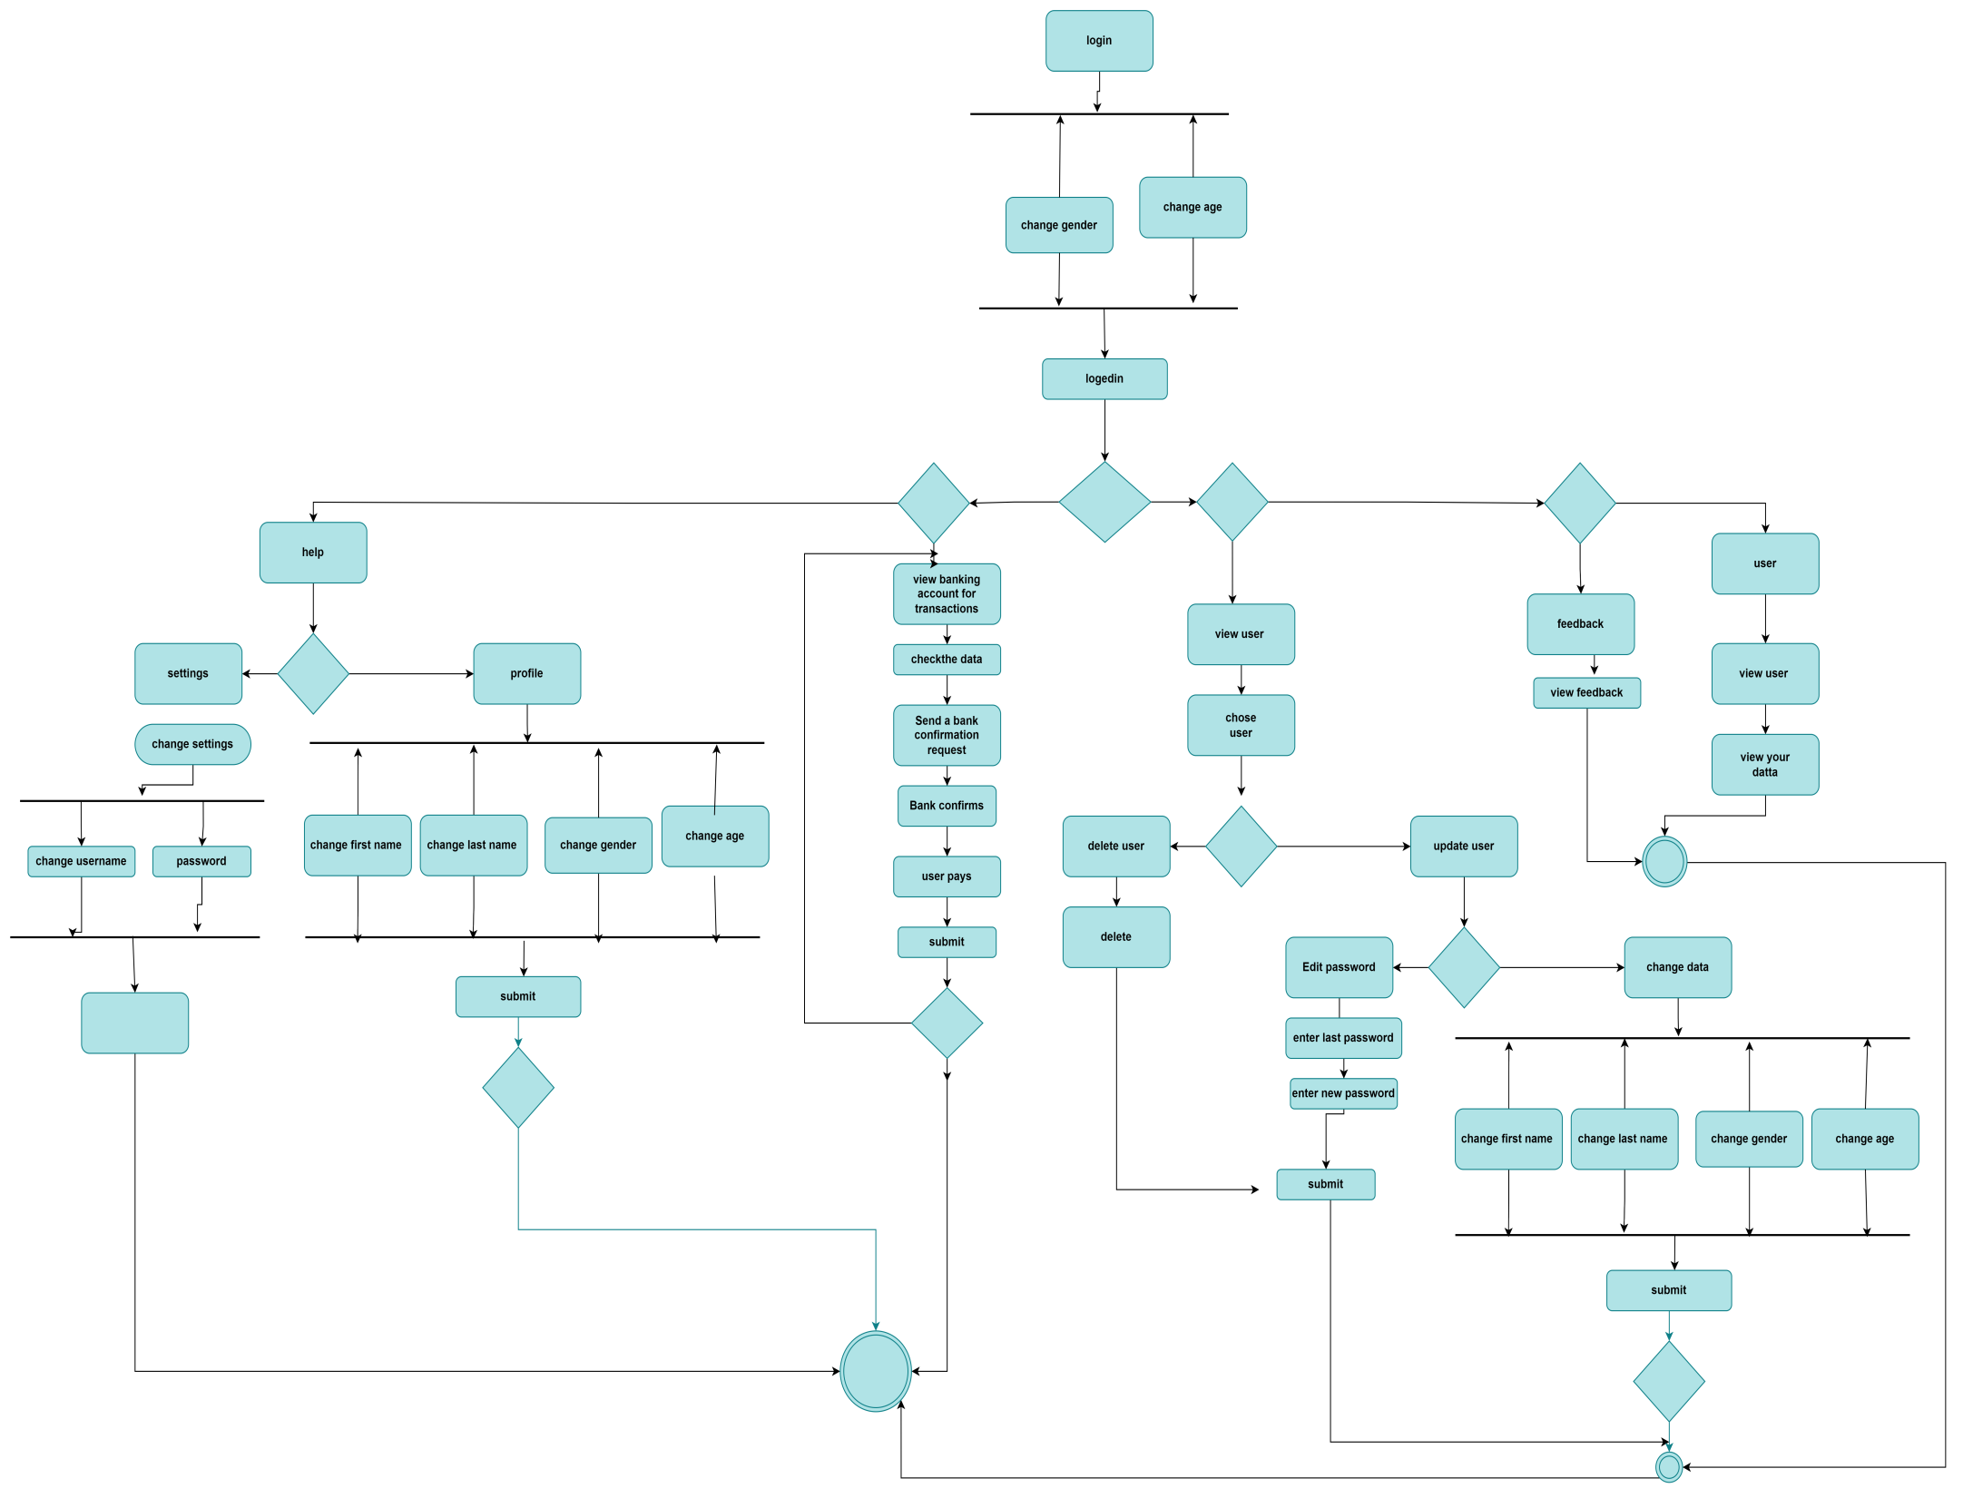
3.2.Admin Activity diagram

Slide 137
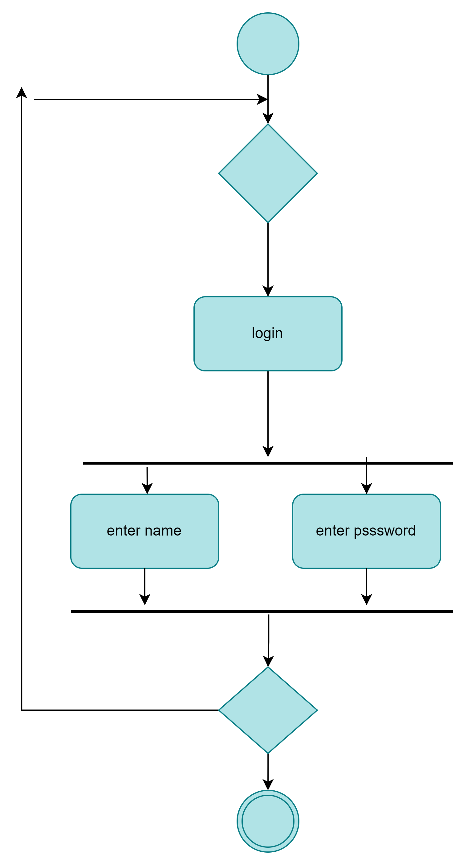
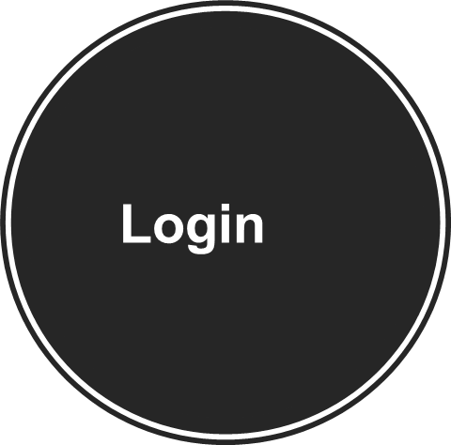

Slide 138
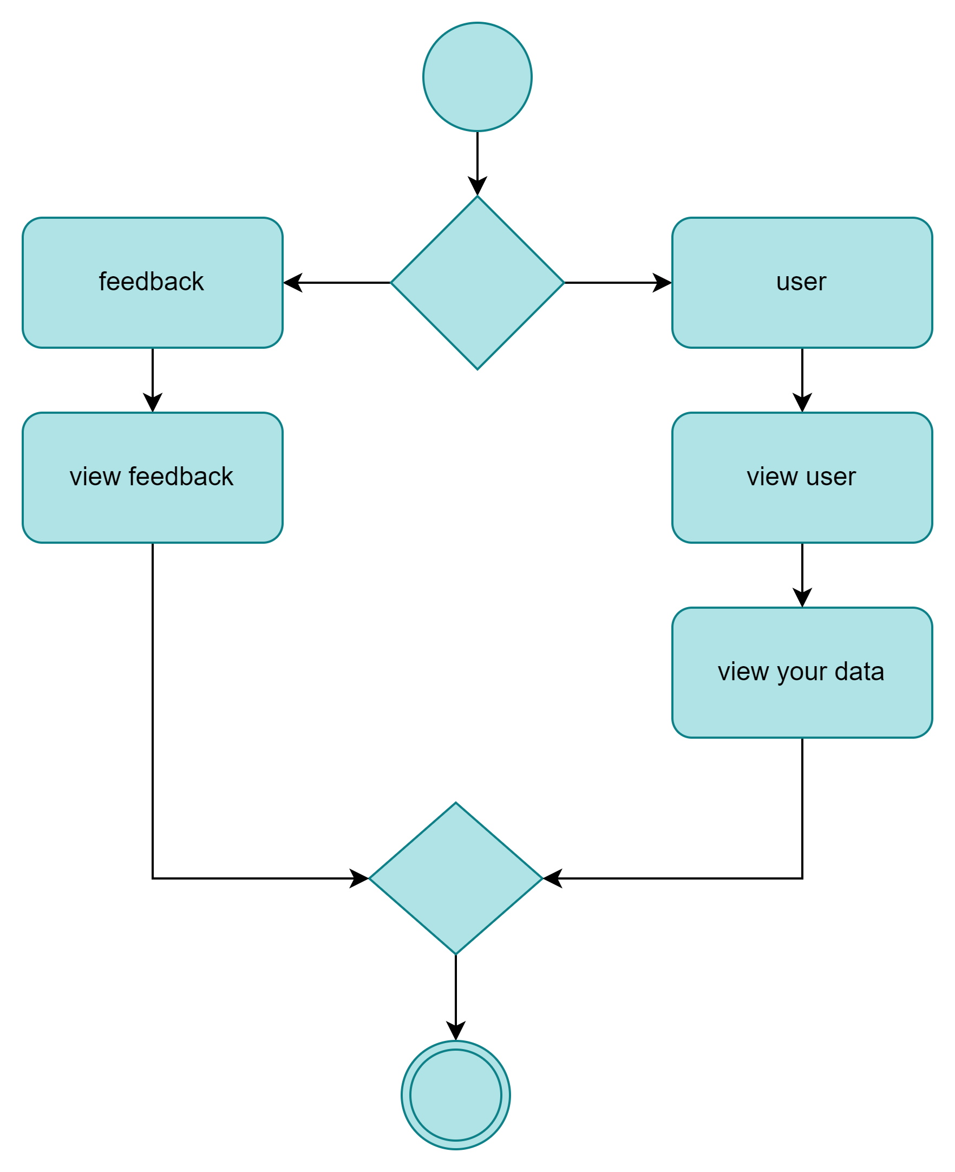
ViewUser&
View
Feedback

Slide 139
Update User&
Delete User

Slide 140
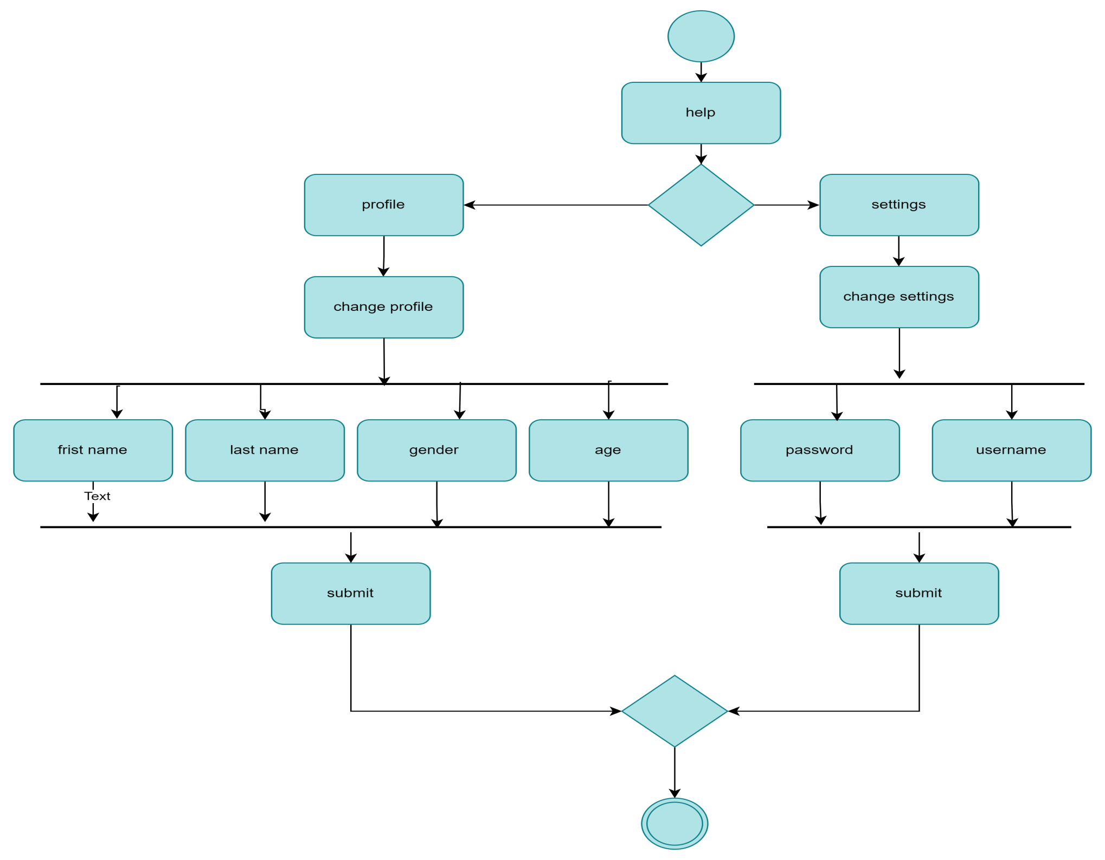
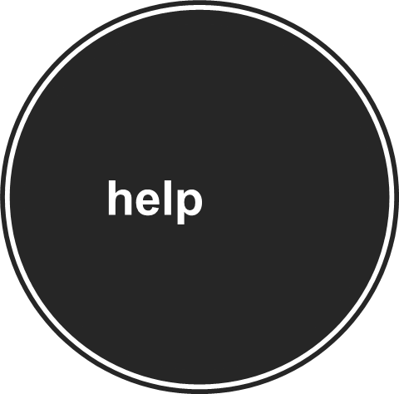

Slide 141
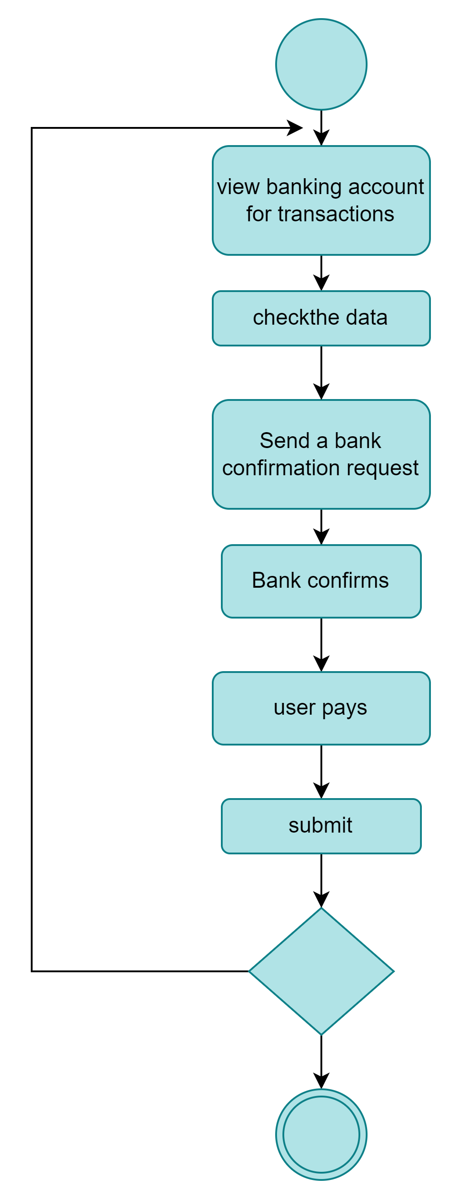
View Bank Account For Transactions

Slide 142
4.Database Specification

Slide 143

4.1.Entity Relationship diagram (ERD)

Slide 144


4.2.Entity Relationship diagram (ERD)

Slide 145
5.Class Diagram

Slide 146

5.1.Class Diagram: Initial Version

Slide 147

5.2.Class Diagram :intermediate Version

Slide 148

5.3.Class Diagram: Final Version

Slide 149
6.Sequence Diagram

Slide 150
6.1.User Sequence Diagram

Slide 151

Login User

Slide 152

Registration

Slide 153

update

Slide 154

blocking

Slide 155

Bank account

Slide 156
6.2.Admin sequence Diagram

Slide 157
Admin experience:
Admin taking actions about users
Including
View , update , delete , activate account

Slide 158
6.3.System Sequence Diagram User

Slide 159

Registration

Slide 160

login

Slide 161

Search

Slide 162


Slide 163

7.1.Package Diagram use case

Slide 164

7.1.Package Diagram classes

Slide 165
8.Object Diagram

Slide 166

Object Diagram

Slide 167
9. System Architecture

Slide 168

9.1Client - Server Architecture mixed Database (BLACK-BOARD)
It describes the overall structure of the system in a high level of abstraction. This is a model used to define the behavior and structure of the system. It is a formal way to describe and represent the
system. The software architecture consists of components, and it compares between these components, its visible properties and the relation between them. It also separates the overall structure of the system from the internal details. When we use the software architecture system, we will be able to solve complexity, reuse some parts and support flexibility and future evolution.

Slide 169

Phase 2

Slide 170

10.1.User Collaboration /Communication Diagram

Slide 171

Login user

Slide 172

Registration

Slide 173

View & Update Profile

Slide 174

Search & View Its Result

Slide 175

Write Feedback

Slide 176
Admin Collaboration /Communication Diagram

Slide 177

Login admin

Slide 178

View calls

Slide 179

View &
Update Profile

Slide 180

View users

Slide 181

Update users

Slide 182

Delete users

Slide 183

Access feedback

Slide 184
Mandatory Design Pattern Applied

Slide 185
Singleton Pattern
Type:
creational pattern
Intent:
singleton is a creational design pattern that lets you ensure that a class has only one instance, while providing a global access point to this instance.
Problem:
-Ensure that a class has just a single instance
- Provide a global access point to that instance
Solution:
-Make the default constructor private, to prevent other objects from using the new operator with the Singleton class.
-Create a static creation method that acts as a constructor. Under the hood, this method calls the private constructor to create an object and saves it in a static field. All following calls to this method return the cached object.
Participants:
The singleton class must provide a global access point to get the instance of the class.
Singleton pattern is used for logging, drivers objects, caching and thread pool.
Singleton it use to limit the numbers of object instance to one

Slide 186
Consequences
Controls access:
-The Singleton class can easily control who accesses its single instance and how.
Permits subclassing: -
The Singleton class can be subclassed. Subclasses can return an object that behaves differently than originally intended. This allows client applications to be configured at runtime by selecting a different subclass.
Enhances flexibility: -
An alternative to the Singleton class would be to create a class with only static members .
Since static members have only one value per class, the immediate effect would be similar. However, pure static members do not lend themselves to subclassing. Furthermore, it is often easier to work with instance methods and fields when the same object must be used in different objects at the same time.

Slide 187
observer pattern
Type:
behavioral pattern
Intent:
Observer is a behavioral design pattern that lets you define a subscription mechanism to notify multiple objects about any events that happen to the object they’re observing.
Problem:
-A change to one object requires changing the other object and you do not know how many objects need to change. -An object should be able to notify other objects without making assumptions about the identity of those objects.
- A one-to-many dependency between objects should be defined without making the objects tightly coupled.
- It should be ensured that when one object changes state, an open-ended number of dependent objects are updated automatically.
- It should be possible that one object can notify an open-ended number of other objects.
Solution:
-Define subject and observer objects
- when a subject changes state, all registered observers are notified and updated automatically (and probably asynchronously).

Slide 188
Participants:
*Subject
-knows its observers. Any number of Observer objects may observe a subject.
-provides an interface for attaching and detaching Observer objects.
*Observer
-defines an updating interface for objects that should be notified of changes in a subject.
*Concrete Subject
-stores state of interest to Concrete Observer objects.
-sends a notification to its observers when its state changes.
*Concrete Observer
-maintains a reference to a Concrete Subject object.
-stores state that should stay consistent with the subject's.
-implements the Observer updating interface to keep its state consistent with the subject's.
Consequences:
-Abstract coupling between subject and observer
-Support for broadcast communication

Slide 189
Memento pattern
Type:
Behavioral Pattern
Content:
It’s a pattern uses to take a capture or a copy of some objects to restore its initial data when its needed.
Problem:
-How can we make a copy of object’s data and restore it to its initial values when it needed.
Solution:
The initial state of the object which include some state variables will be stored. To use this pattern, we will create two interfaces, an interface to the caretaker that ignore the access to the stored initial state. The other interface is to the originator, and it allows originator to access the state variables to restore object’s initial state.

Slide 190

thanks

